Slide 1
Guidelines for the selection of digital heritage for long-term preservation
Clément Oury
ISSN International Centre
PERSIST Content Task Force clement.oury@issn.org
The UNESCO PERSIST Content Task Force
Notes:
The UNESCO PERSIST content taks force and the Guidelines for the selection of digital heritage for longterm-preservation

Slide 2
Agenda of the session
Presentation of the guidelines
Comments on the guidelines from the panel
Open discussion with the public

Slide 3
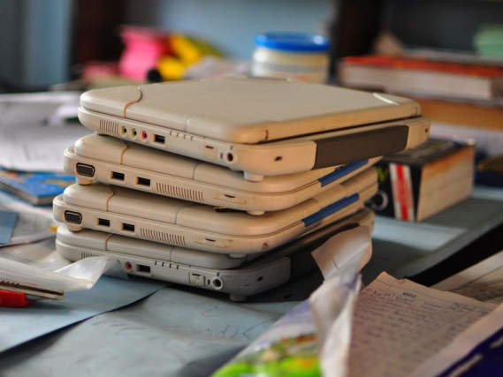
Why preserving digital heritage?
Heritage is at risk of being lost forever
  Sheer volume of information…
  But highly ephemeral
Ensure survival of digital heritage for the next generations and beyond
A need for heritage institutions to define their digital heritage preservation strategy
Notes:
Stressing the point that it is essential, if not already to late, to tackle digital preservation and that selection is essential. National institutions need to step forward and address this subject and need adequate funding from the government to do their job.
If selection and preservation of digital heritage is not addressed NOW, there is a high risk of loosing decades worth of content and leaving a significant digital black hole for future generations.
3

Slide 4
The PERSIST project
PERSIST: Platform to Enhance the Sustainability of the Information Society Transglobaly
A progressive maturation
  Memory of the World 2012 conference in Vancouver
  December 2013: international conference in the Hague, launch of PERSIST
A roadmap for three task forces
  Selection
  Policy
  Technology
Notes:
Vancouver: UBC/UNESCO Vancouver Declaration, the memory of the world in the Digital Age: digitization and preservation = a call for action
4

Slide 5
Content Selection Guidelines – the context
The Content Task Force was created to provide guidance to memory and cultural institutions on selecting digital material for long term preservation.
UNESCO: UNESCO Guidelines are not legally binding. Member states are invited to apply them as the baseline or best practices.
Guidelines are not a list of recipes!
Notes:
Setting the context:
Why are we doing this – not knowing what to preserve was identified as one of the major problems during the kick off meeting in 2013. We need to know what we have, what is out there, how it fits into the mandate of the institution and then think about preserving it
Unesco has many instruments to help standardise issues. Guidelines are non binding but a Member States are invite to use them. We strongly recommend that they will be used by Member States once the final product presented here has been passed through the UNESCO General Conference
We are aiming our Guidelines a libraries, archives and museums. At the big ones, and the small ones. They are a starting point for every institution which needs a starting point to tackle to huge issue of digital preservation and how to select content for this immense task.
5

Slide 6
Content Selection Guidelines – the context (cont’d)
The Content Selection Guidelines are designed primarily for libraries, archives and museums
A Generic Framework: for general application (with advice on specific application)
Audience: aim at a diverse audience including professionals and administrators who deal with digital materials and plan to prepare a policy on selection of digital materials for long-term preservation.
Notes:
We are aiming our Guidelines a libraries, archives and museums. At the big ones, and the small ones. They are a starting point for every institution which needs a starting point to tackle to huge issue of digital preservation and how to select content for this immense task.
“The aim of the Guidelines is to provide an overarching starting point for libraries, archives, museums and other heritage institutions when drafting their own policies on the selection of digital heritage for long-term sustainable digital preservation. Existing institutional policies may be assessed against the Guidelines and revised if required”.
6

Slide 7
The authors of the Guidelines
  Chair: Ingrid Parent (University of British Columbia)
  Secretary: Julia Brungs (IFLA)
  Authors:
  Ngian Lek Choh (National Library Board of Singapore – IFLA Governing Board, Singapore)
  Clement Oury (ISSN International Centre, France)
  Katarzyna Ślaska (National Library of Poland, Poland)
  Sarah CC Choy (Legislative Council Archives, Hong Kong)
  Robert Fisher (Library and Archives Canada, Canada)
  Nicholas Crofts (ICOM, CIDOC, Switzerland)
  Susanne Nickel (City Museum of Eskilstuna, Sweden)
Notes:
Writers are representing Libraries, Archives and Museums as Guidelines span across all these sectors. They do share common issues with the selection of digital heritage. The Guidelines are a starting points for institutions to adapt and use for their own needs and situations. They stress the importance of selection in order to ensure the survival of our digital heritage for the future.

Slide 8

Background – how did we get here?
‘The Paradox of Selection in the Digital Age’ -- T. and B. Van der Werf (August 2014)
Survey on existing digital selection policy – W. Helmus (April 2015)
The Content Task Force created a working group of experts to draft the Guidelines for the selection of digital heritage for long-term preservation in April 2015
Extensive consultation throughout 2015
Notes:
Some notes on the background – we had an interesting 2 year journey to get where we are now.
Firstly we asked Titia and Bram van der Werf to write a thought provoking paper which we presented at WLIC2014 in Lyon and received a lot of feedback on.
Based on this we asked Wilbert Helmus (Network Digital Heritage, Netherlands) in early 2015 to conduct a survey with heritage institutions on digital selection standards which are already in use – we did not want to reinvent the wheel!
Following from the paper and the background survey, we decided it is time to tackle the problem head on a create a group of authors who will write Guidelines. We decided that the Guidelines will be applicable, as much as possible, for libraries, archives and museums and we therefore asked 7 people from these three sectors to join our group. (no worries, we will show you the full list of all the writers towards the end)
We had several drafts, 4 in total, and consulted with experts from all of the sectors via mail, at conferences through presentations and workshops and with the wider PERSIST group on the Guidelines.
8

Slide 9
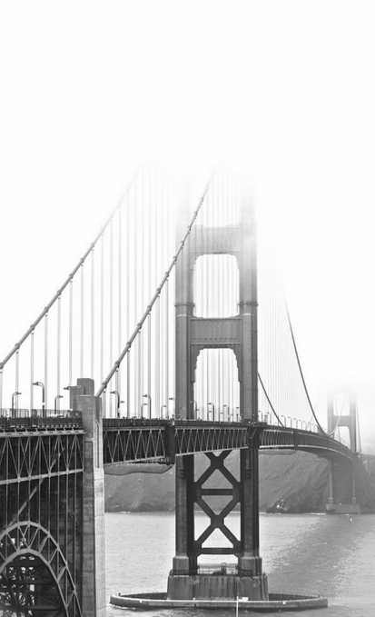
Challenges we encountered
Different terminology used by librarians, archivists and museum professionals
Diversity of the heritage community - Guidelines to be applied by libraries, archives, and museums of all shapes and sizes
Different professional focuses and priorities:
  Libraries – issues relating to legal deposit, e-publications, harvesting websites and social media sites, and short-term vs. long-term use
Notes:
Along the way we encounter some challenges, many we managed to overcome with our author team. Some might need to be addressed at later stages (e.g. how to deal with Ethics)
9

Slide 10
Challenges we encountered
  Museums – born-digital material / digital or digitized information about the collection / digital representations of physical artefacts.
  Importance of metadata and context information
  Archives – authenticity of records, early selection and transfer, reappraisal, costs, regulatory restrictions on access and use
  Private sector in background
  Some issues not tackled: e.g. ethics
Notes:
Along the way we encounter some challenges, many we managed to overcome with our author team. Some might need to be addressed at later stages (e.g. how to deal with Ethics)
10

Slide 11
Identifying success conditions
  Networking
    Critical role of the national/central institution
    Which cannot act without the support of a network
  Legal environment
    IP rights issues; privacy; state secrets
    Institutions need to be mandated
  Technical skills
    Metadata management
    Digital preservation

Slide 12
The selection paradox
  Selection is not possible
    New forms of digital heritage that should not be forgot
    Collectively valuable as a record of contemporary societies
  Selection is mandatory
    Huge amount of resources created by digital technologies
  Selection strategies should be adopted
    Comprehensive collection
    Representative collection
    Selection
Notes:
Otherwise, gaps and bias

Slide 13

Criteria for Selection Guidelines
We MUST select, based on:
Three main criteria
  Significance
  Sustainability
  Availability
A decision tree for selection in individual institution
Notes:
In the current situation of rapidly evolving technology, we HAVE to select digital heritage we want to preserve as we cannot predict what possibilities will be availablein the future.
If we do not select now, there is a high chance that large quantities of heritage will be lost and future generation will not be able to benefit from the achievements of the current generations.
For this institutions need to evaluate the SIGNIFICANCE, SUSTAINABILTY and AVAILABILITY of the digital heritage presented in order to make an informed decision on where to select the heritage for preservation or not.

Slide 14
Questions, Comments and Suggestions
Cultural.heritage@ifla.org
Julia.Brungs@ifla.org

Slide 15
Questions for the panel
Do you have a collecting policy/strategy
  For digital documents?
What are digital preservation issues in your institutions?
How to use/implement guidelines?

