Slide 1

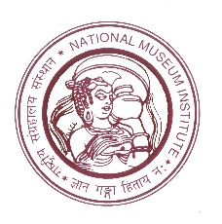
CIDOC 2015
Report
Prof. (Dr.) Manvi Seth
Convenor, CIDOC 2015
Head of Department, Museology
National Museum Institute
of History of Art, Conservation and Museology
(Deemed to be University)
Ministry of Culture, Government of India

Slide 2

CIDOC 2015
Comité International pour la Documentation
International Committee for Documentation
New Delhi, India
05.09.2015 - 10.09.2015
Documenting Diversity – Collections, Catalogues & Context
Overview of the Conference
Venue: National Museum Institute of History of Art, Conservation and Museology, New Delhi
Theme: Documenting Diversity- Collections, Catalogues & Context
Dates: 5th-10th September, 2015
Pre-conference sessions: 5th-6th September 2015
6 Pre-conference sessions which included workshops and working group meetings
Conference Sessions: 7th-9th September 2015
Included 3 Keynotes, 2 special lectures, 6 panel discussions, 93 paper presentations and 6 poster presentations

Slide 3
CIDOC 2015
Comité International pour la Documentation
International Committee for Documentation
New Delhi, India
05.09.2015 - 10.09.2015
Documenting Diversity – Collections, Catalogues & Context
Overview of the Conference
Behind the scene sessions at four different Institutions: 7th-9th September 2015
Curated walk of National Museum on 6th September 2015
Visit to Rashtrapati Bhawan and its museum: 8th September 2015
Welcome Dinner on 7th September
Farewell Dinner on 9th September 2015
Excursion to Taj Mahal: 10th September 2015

Slide 4
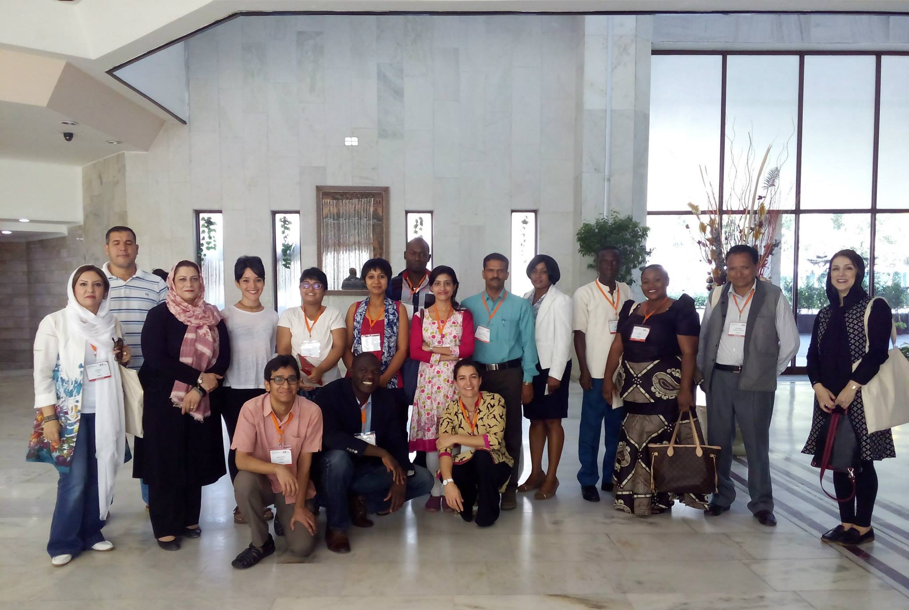
CIDOC 2015
Comité International pour la Documentation
International Committee for Documentation
New Delhi, India
05.09.2015 - 10.09.2015
Documenting Diversity – Collections, Catalogues & Context
Conference Participants
200 people
36 countries
169 registered delegates (including 82 individual-paid, 25 bursary, 4 ICOM grantees and 58 nominated from various cultural organisations)
32 Complimentary conference delegates
Bursary participants and ICOM grantees

Slide 5
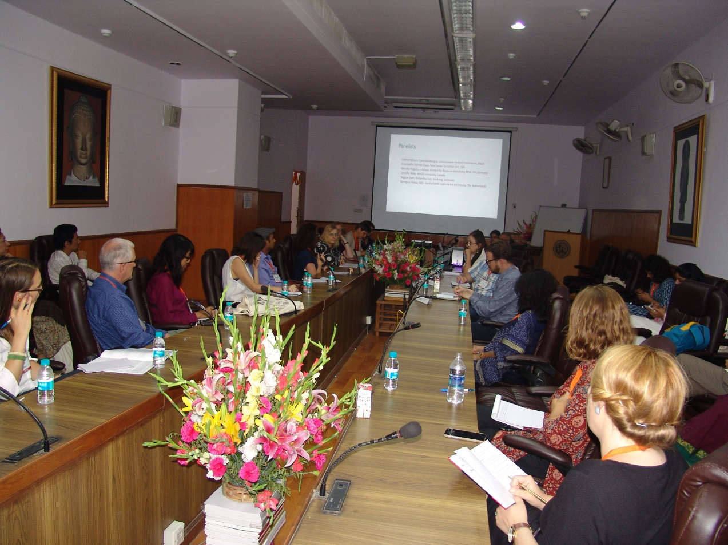
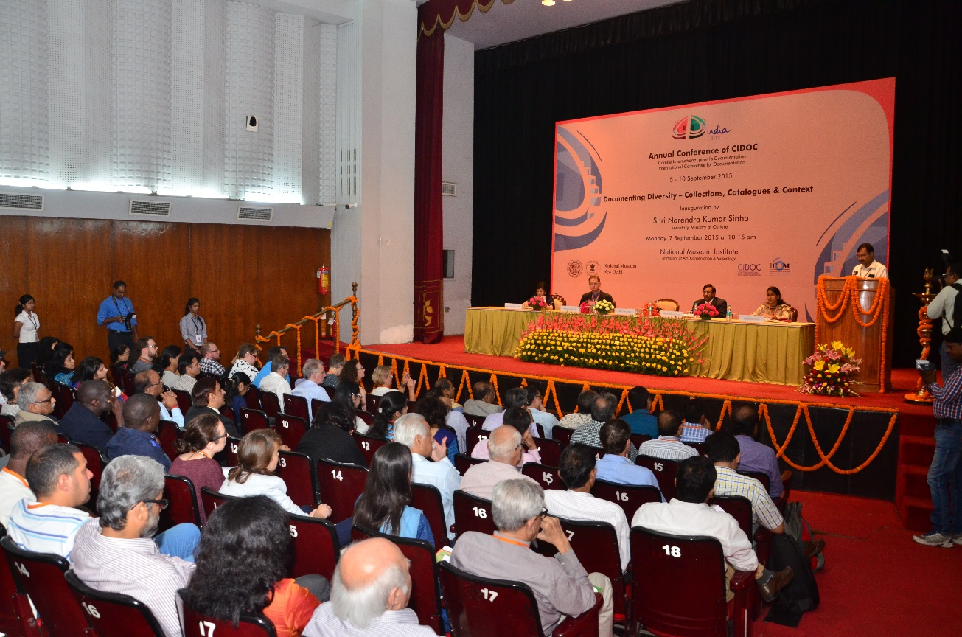
CIDOC 2015
Comité International pour la Documentation
International Committee for Documentation
New Delhi, India
05.09.2015 - 10.09.2015
Documenting Diversity – Collections, Catalogues & Context
Venue
National Museum Institute, New Delhi
National Museum, New Delhi

Slide 6
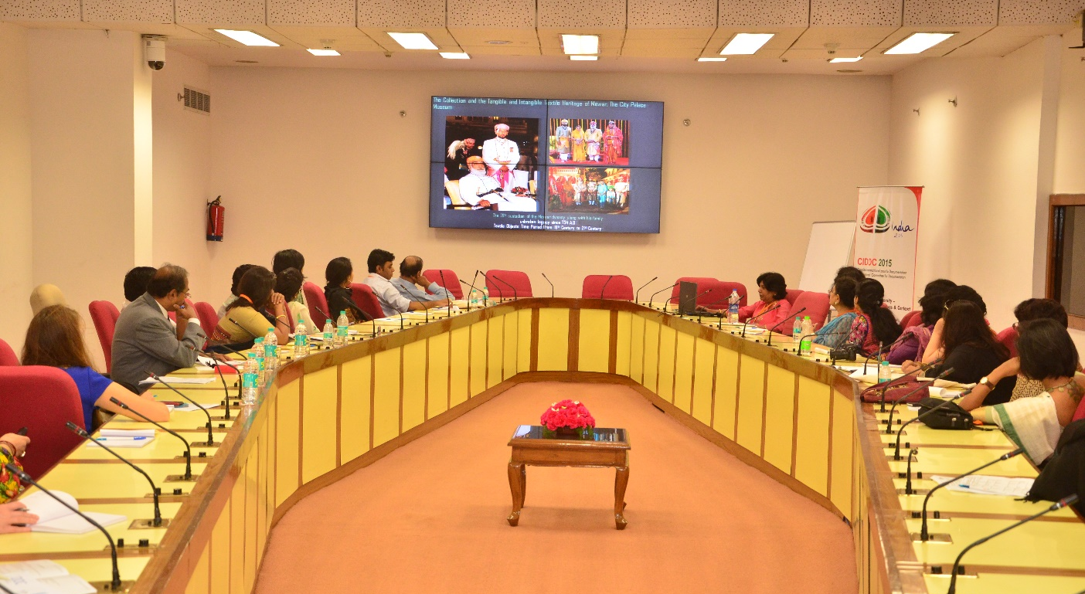
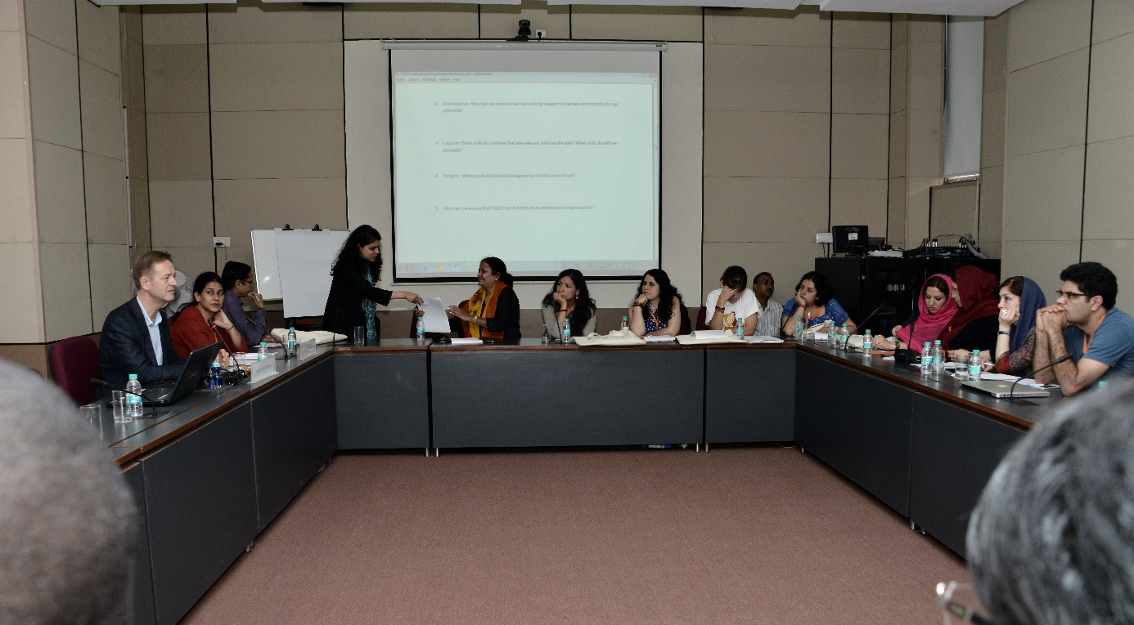
CIDOC 2015
Comité International pour la Documentation
International Committee for Documentation
New Delhi, India
05.09.2015 - 10.09.2015
Documenting Diversity – Collections, Catalogues & Context
Venue
Vigyan Bhavan, New Delhi
National Gallery of Modern Art, New Delhi

Slide 7
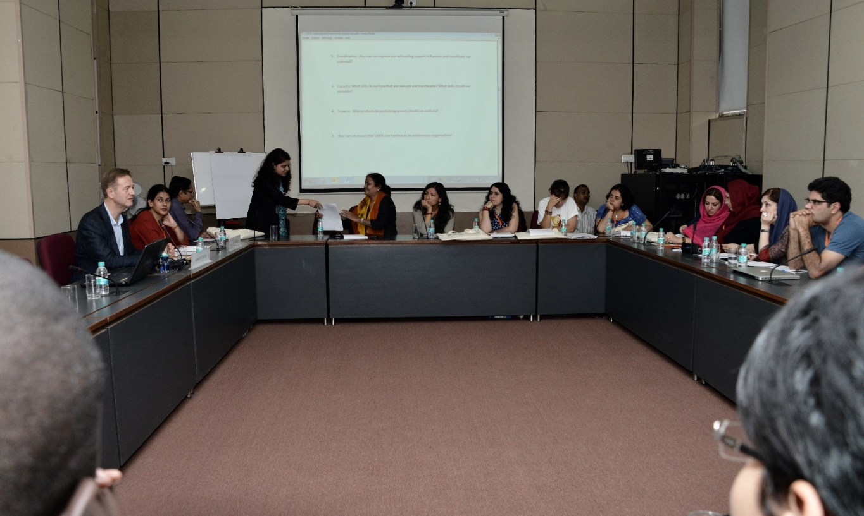
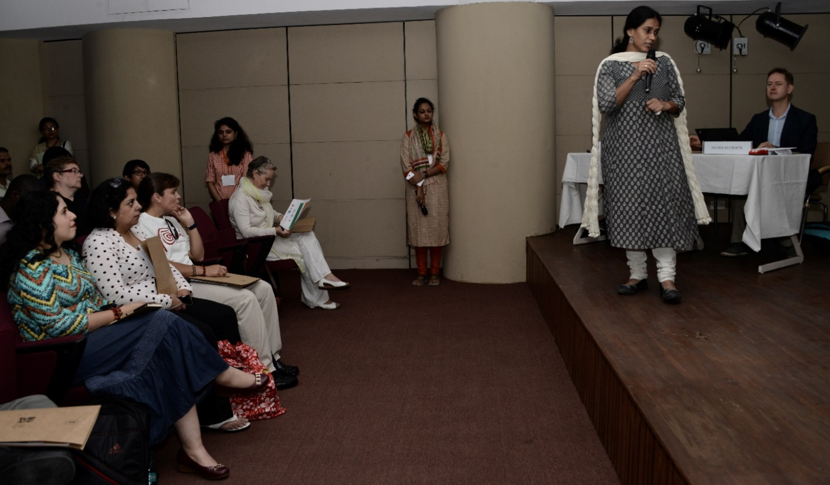
CIDOC 2015
Comité International pour la Documentation
International Committee for Documentation
New Delhi, India
05.09.2015 - 10.09.2015
Documenting Diversity – Collections, Catalogues & Context
Pre Conference Session
Workshop
The Role of CIDOC in International Humanitarian Programmes
Moderator: Nicholas Crofts and Dr. Manvi Seth

Slide 8
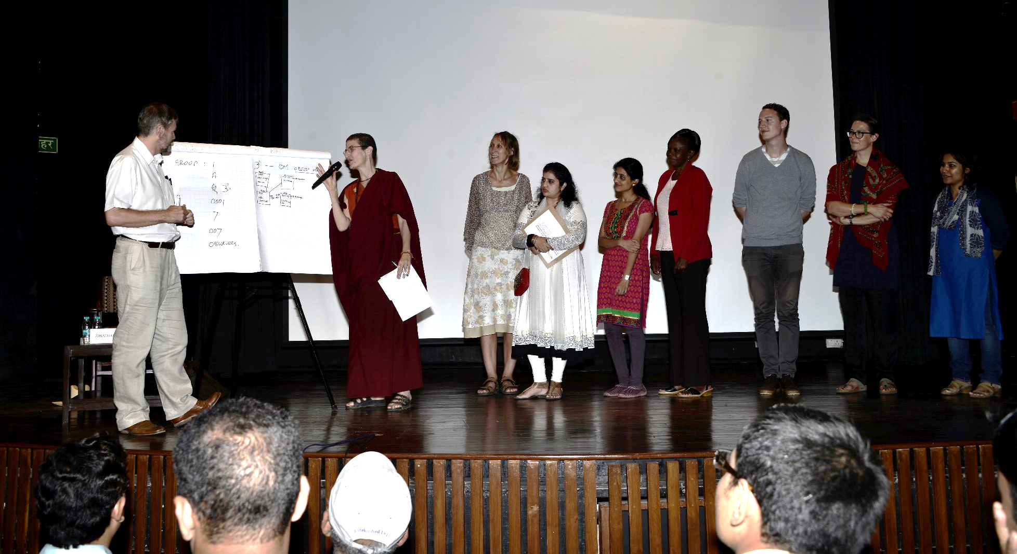
CIDOC 2015
Comité International pour la Documentation
International Committee for Documentation
New Delhi, India
05.09.2015 - 10.09.2015
Documenting Diversity – Collections, Catalogues & Context
Pre Conference Sessions
Workshop
Documentation Standards, Moderator: Jonathan Whitson Cloud

Slide 9
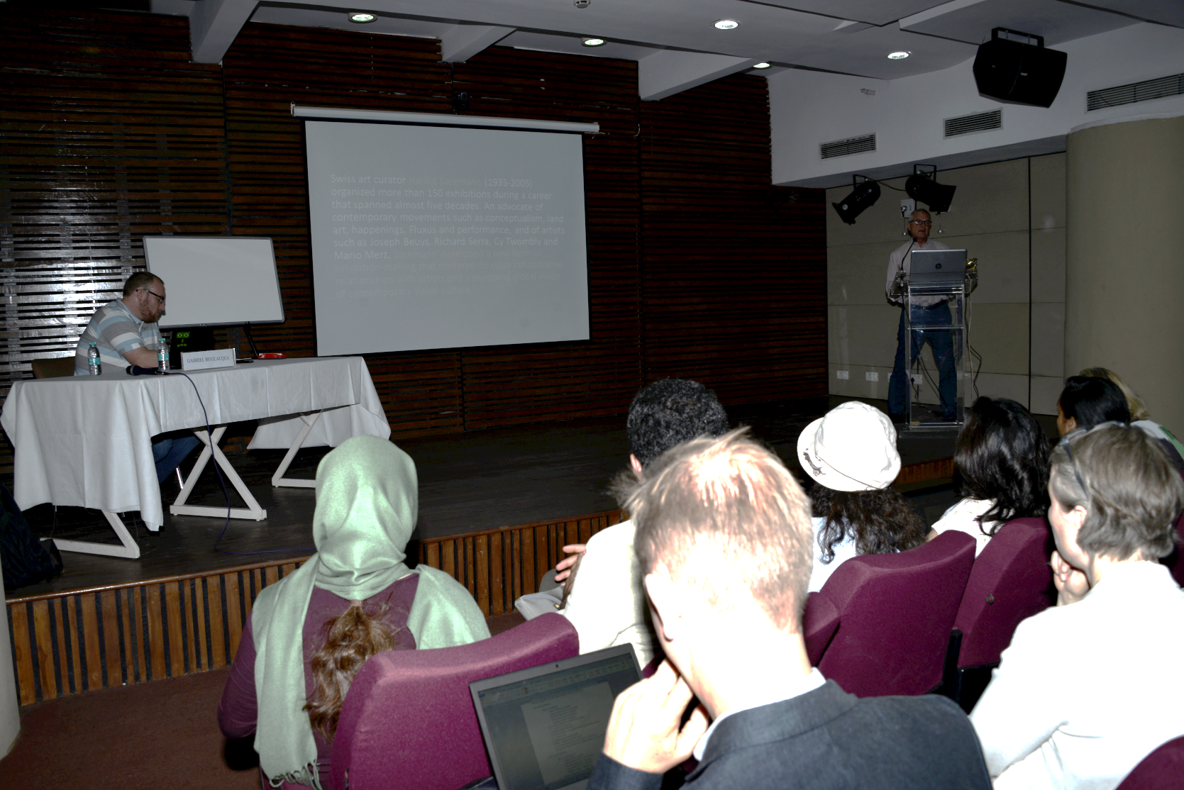
CIDOC 2015
Comité International pour la Documentation
International Committee for Documentation
New Delhi, India
05.09.2015 - 10.09.2015
Documenting Diversity – Collections, Catalogues & Context
Pre Conference Sessions
Workshop
Exhibition and Performance Documentation, Moderator: Gabriel Bevilacqua

Slide 10
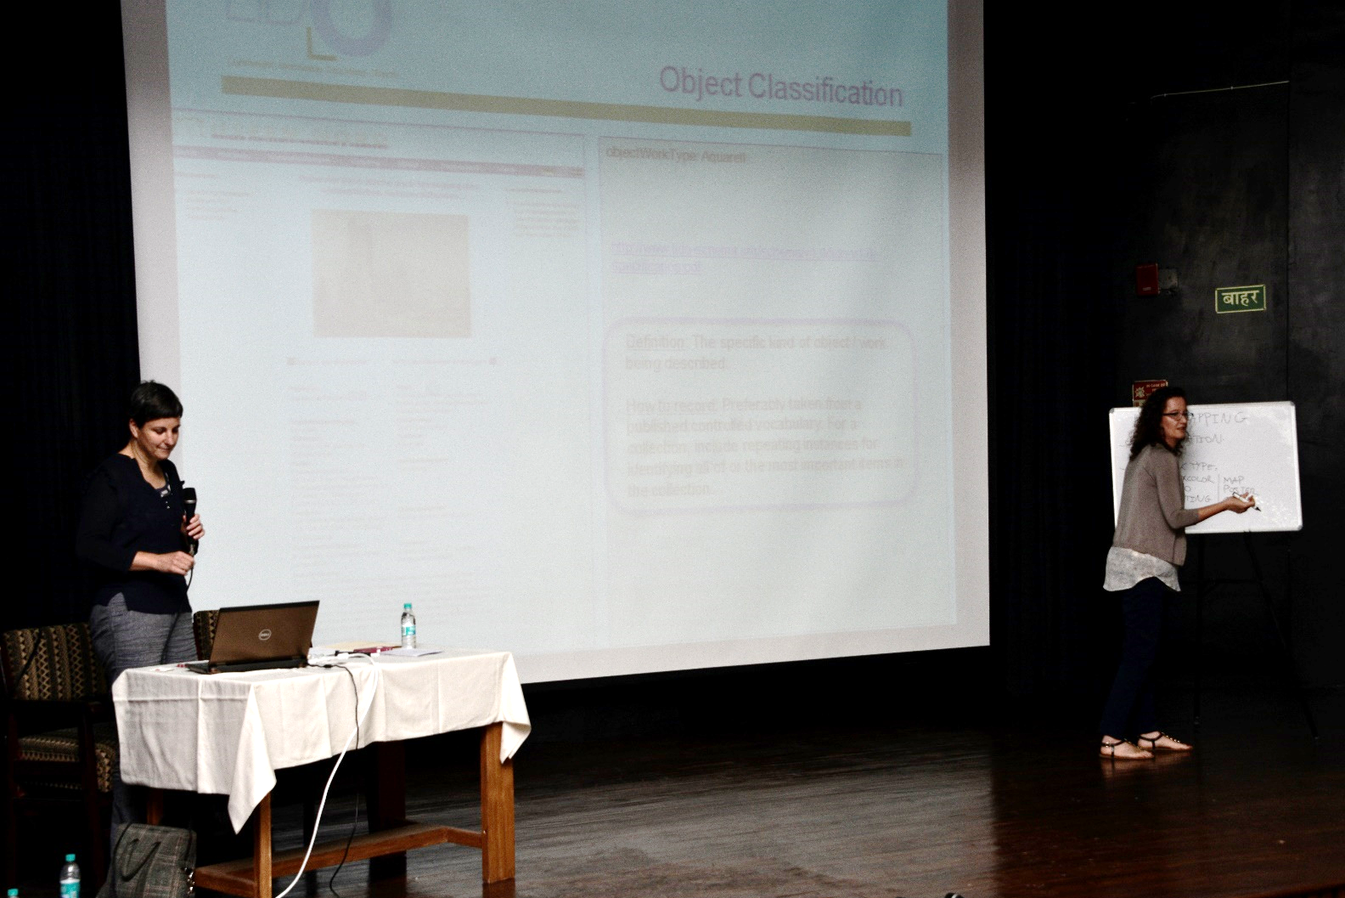
CIDOC 2015
Comité International pour la Documentation
International Committee for Documentation
New Delhi, India
05.09.2015 - 10.09.2015
Documenting Diversity – Collections, Catalogues & Context
Pre Conference Sessions
Workshop
LIDO (Lightweight Information Describing Objects)
Moderator: Regine Stein

Slide 11
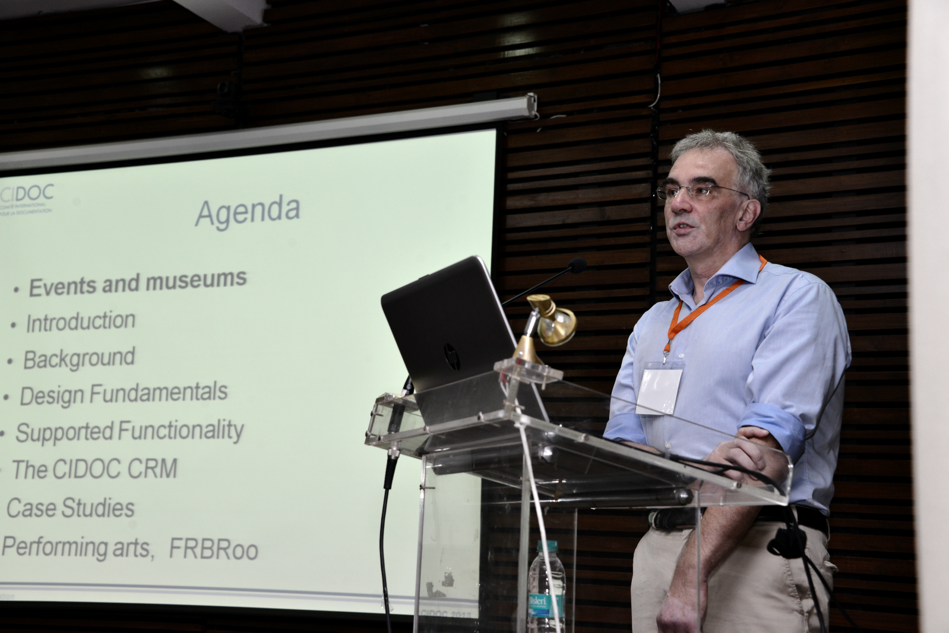
CIDOC 2015
Comité International pour la Documentation
International Committee for Documentation
New Delhi, India
05.09.2015 - 10.09.2015
Documenting Diversity – Collections, Catalogues & Context
Pre Conference Sessions
Workshop
CIDOC CRM / FRBROO++
Moderator: Christian – Emil Smith Ore

Slide 12
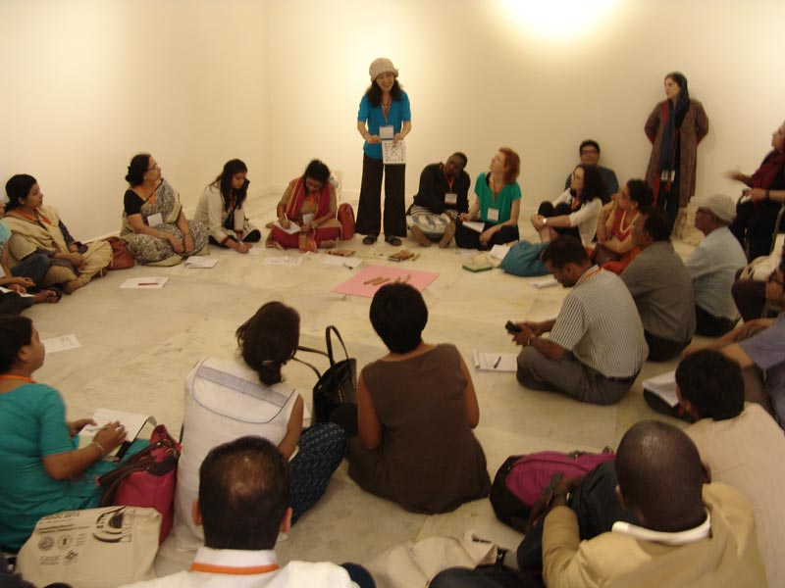
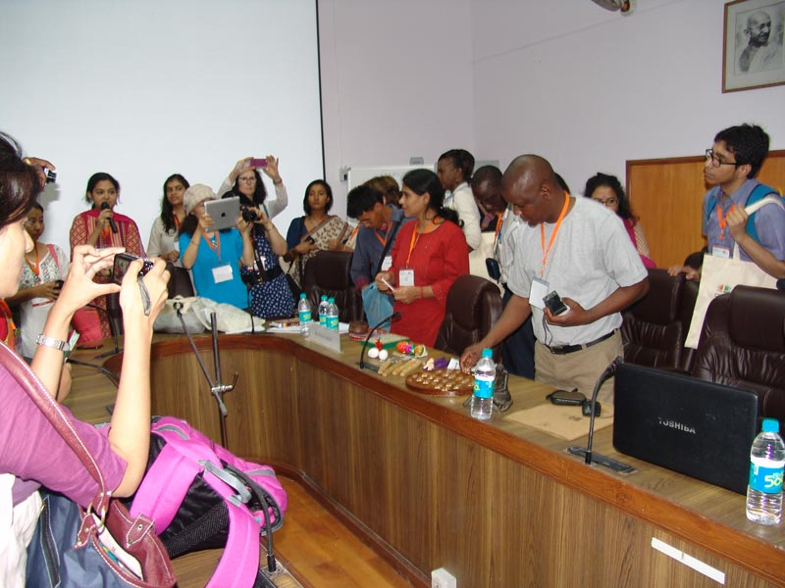
CIDOC 2015
Comité International pour la Documentation
International Committee for Documentation
New Delhi, India
05.09.2015 - 10.09.2015
Documenting Diversity – Collections, Catalogues & Context
Pre Conference Sessions
Workshop
Intangible Cultural Heritage Workshop
Moderator: Dr. Manvi Seth

Slide 13

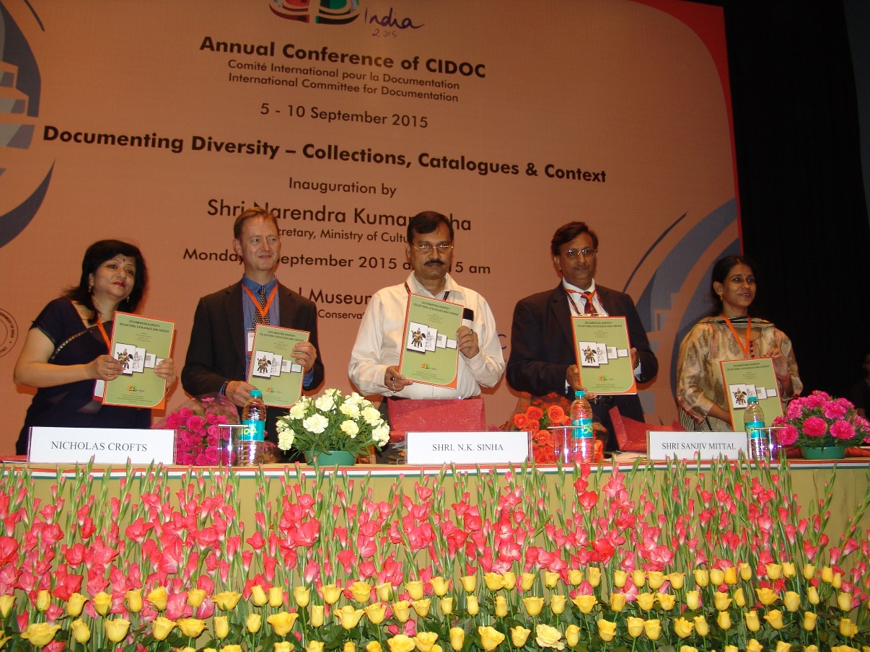
CIDOC 2015
Comité International pour la Documentation
International Committee for Documentation
New Delhi, India
05.09.2015 - 10.09.2015
Documenting Diversity – Collections, Catalogues & Context
Inaugural
Conference inaugurated by the Secretary, Ministry of Culture, Government of India

Slide 14
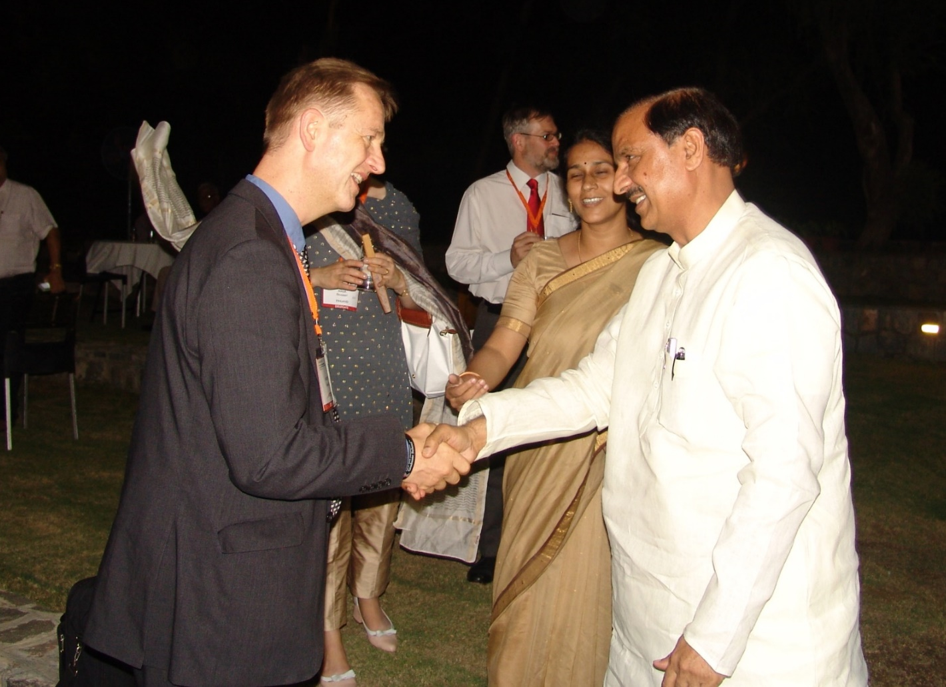
CIDOC 2015
Comité International pour la Documentation
International Committee for Documentation
New Delhi, India
05.09.2015 - 10.09.2015
Documenting Diversity – Collections, Catalogues & Context
Welcome Dinner
Welcome Dinner hosted by Dr. Mahesh Sharma, the Hon’ble Minister of State of Tourism and Culture (Independent Charge) and Civil Aviation, Government of India.

Slide 15
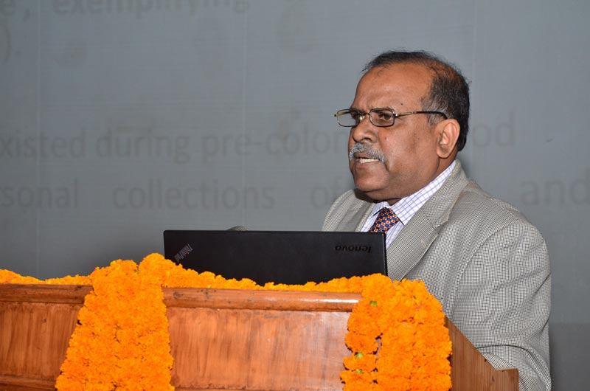
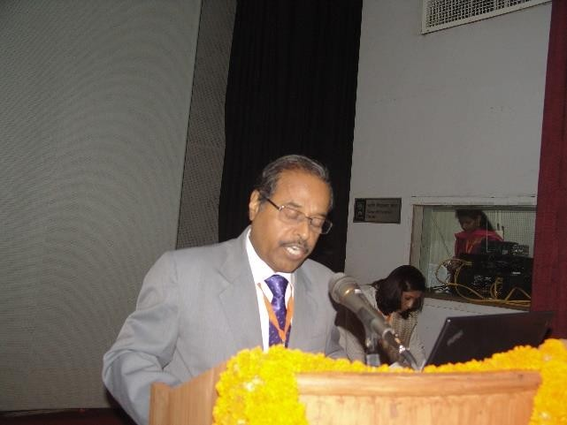
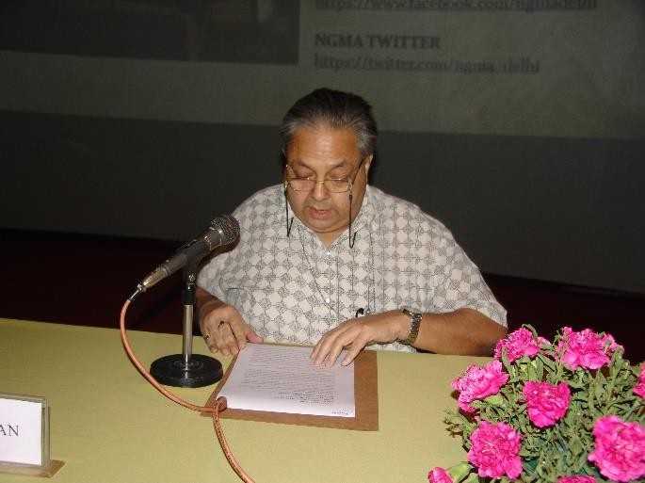
CIDOC 2015
Comité International pour la Documentation
International Committee for Documentation
New Delhi, India
05.09.2015 - 10.09.2015
Documenting Diversity – Collections, Catalogues & Context
Conference Session
          Keynote
Prof. (Dr.) Kamal K. Mishra
Title: Context, Meaning and Politics of Representation: An Anthropological Approach to Museums
Prof. Kishor K. Basa,
Title: Museum, Community and Access: Documenting Collection and Moving Beyond
Prof. Rajeev Lochan
Title: Rethinking and Documenting Cultural Diversity

Slide 16
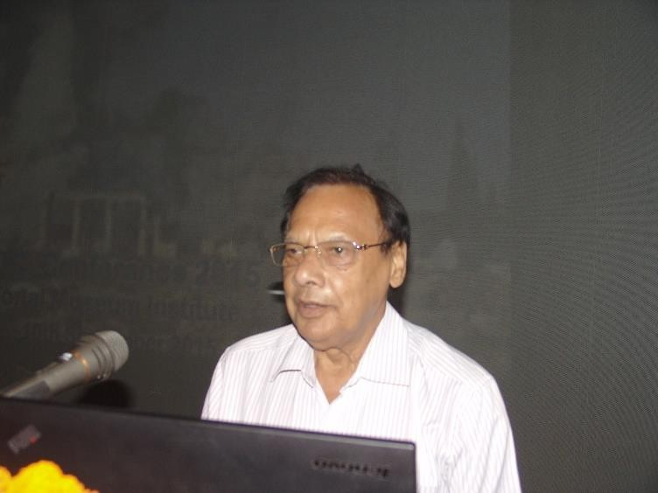
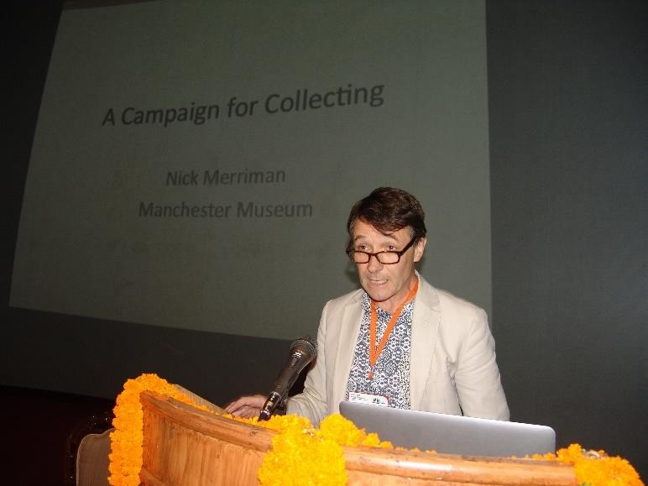
CIDOC 2015
Comité International pour la Documentation
International Committee for Documentation
New Delhi, India
05.09.2015 - 10.09.2015
Documenting Diversity – Collections, Catalogues & Context
Conference Session
          Keynote
Dr. R. S. Bisht
Title: Documenting the Past for the Future
Dr. Nick Merriman
Title: A Campaign for Collecting

Slide 17
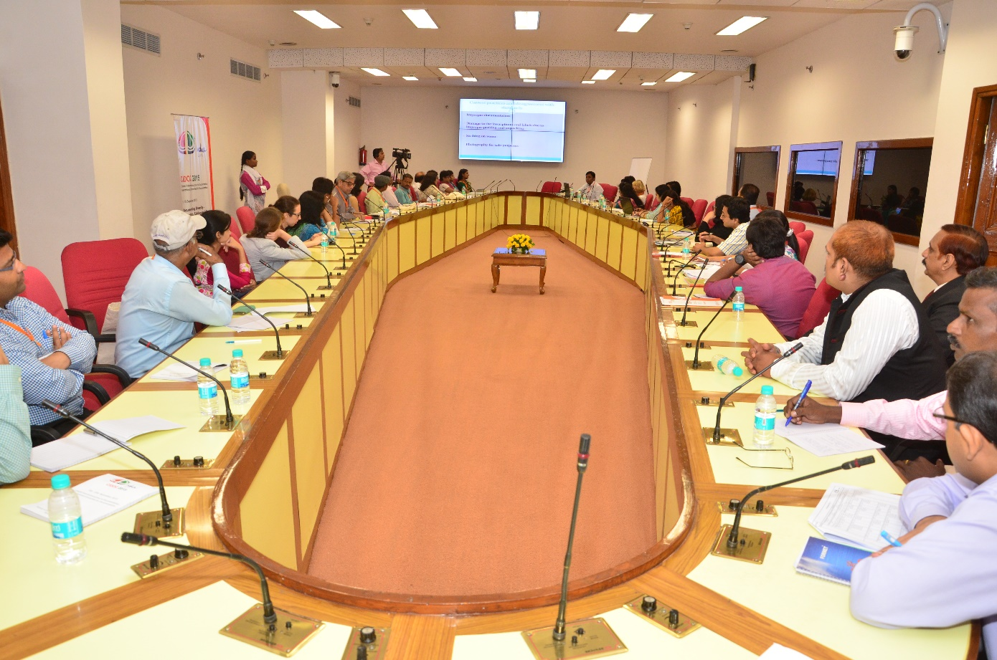
Paper Presentations
Papers were presented on conference related themes at the National Museum Institute, National Museum and Vigyan Bhawan, New Delhi from 7th – 9th September 2015
Each session had around 5 paper presentations followed by discussions on them.
The total number of delegates who presented the papers on various themes was 93.

Slide 18
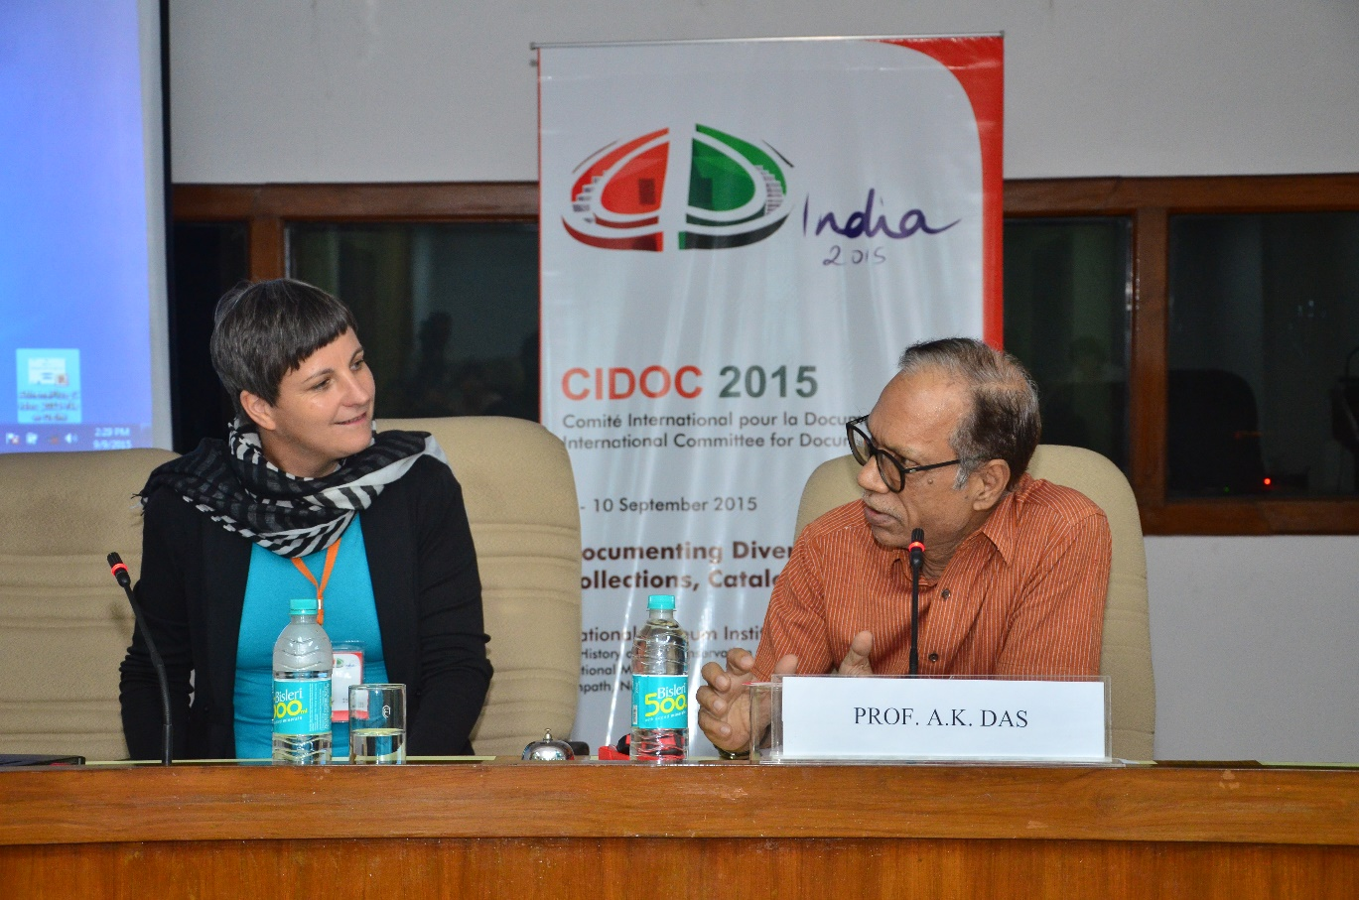
CIDOC 2015
Comité International pour la Documentation
International Committee for Documentation
New Delhi, India
05.09.2015 - 10.09.2015
Documenting Diversity – Collections, Catalogues & Context
Paper and Poster Presentations
A total of 31 papers were presented on various topics related to the theme Strategies and policies for documenting the diversity of culture
40 papers were presented on the theme Techniques and methods of documentation
22 papers were presented related to the theme Access and Integration - working together with archives and other heritage institutions.
A total of 6 poster presentations were displayed on conference related themes

Slide 19
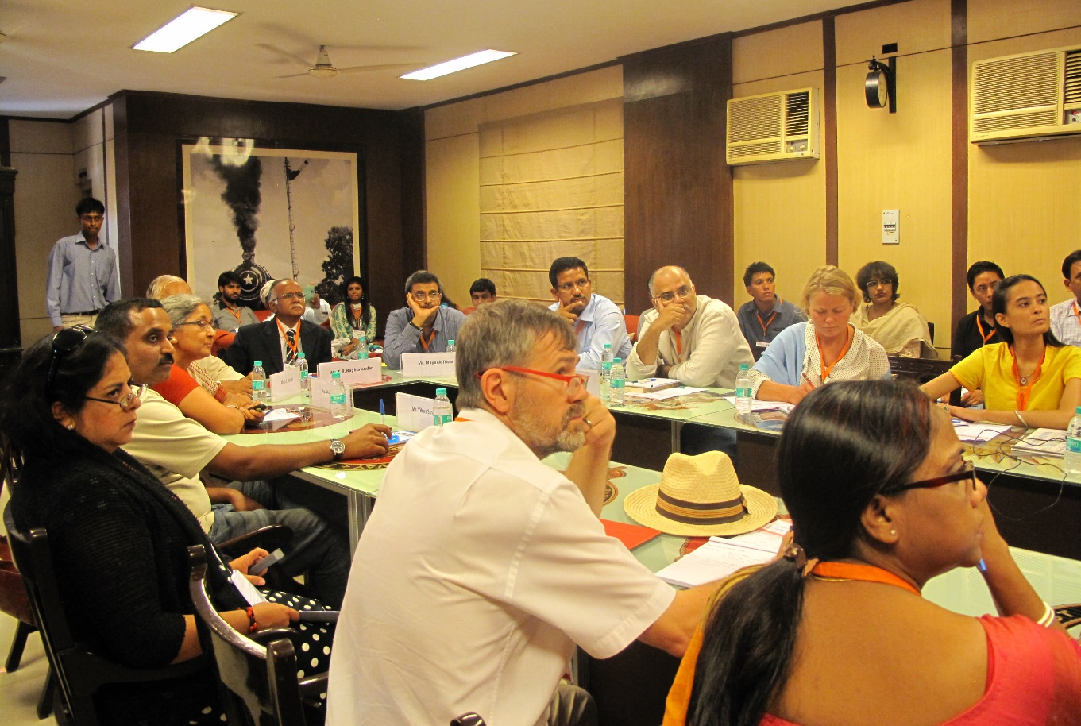
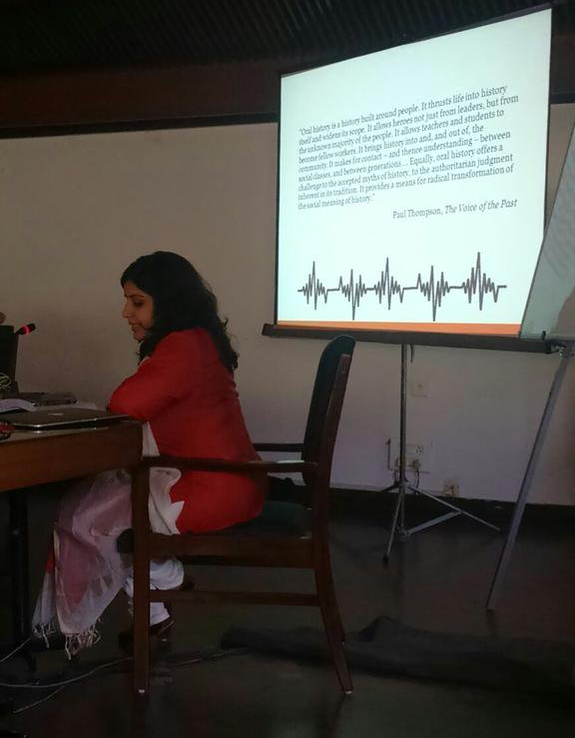
CIDOC 2015
Comité International pour la Documentation
International Committee for Documentation
New Delhi, India
05.09.2015 - 10.09.2015
Documenting Diversity – Collections, Catalogues & Context
Panel Discussions
Documentation of Industrial Heritage
Moderator: T.R. Raghunandan
Archiving Contemporary India: New Challenges
Moderator: Dr. Hari Sen

Slide 20
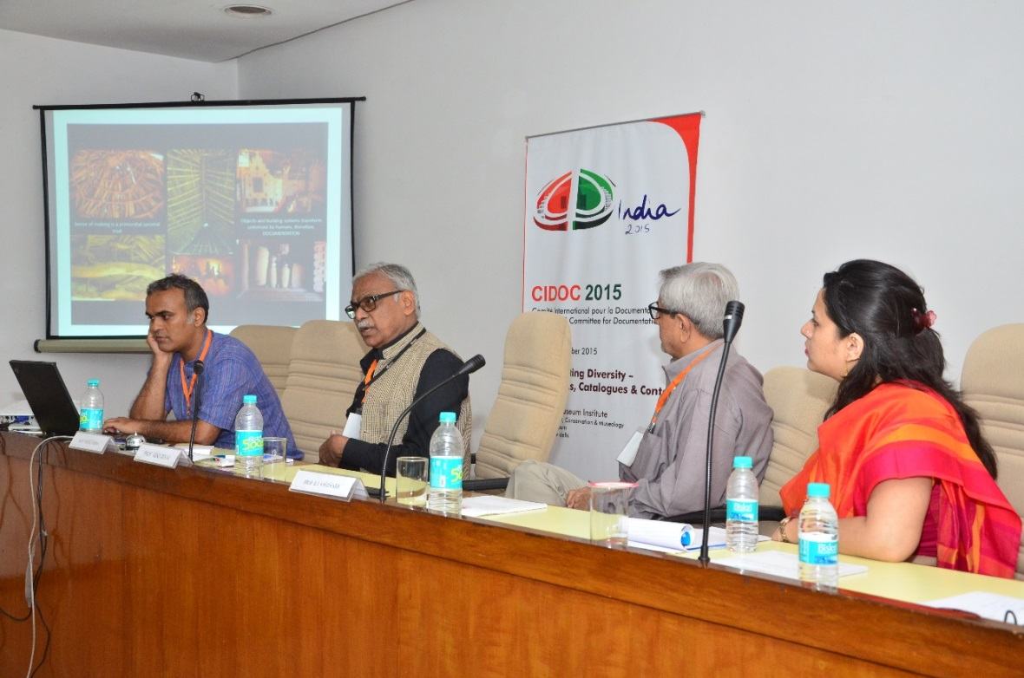
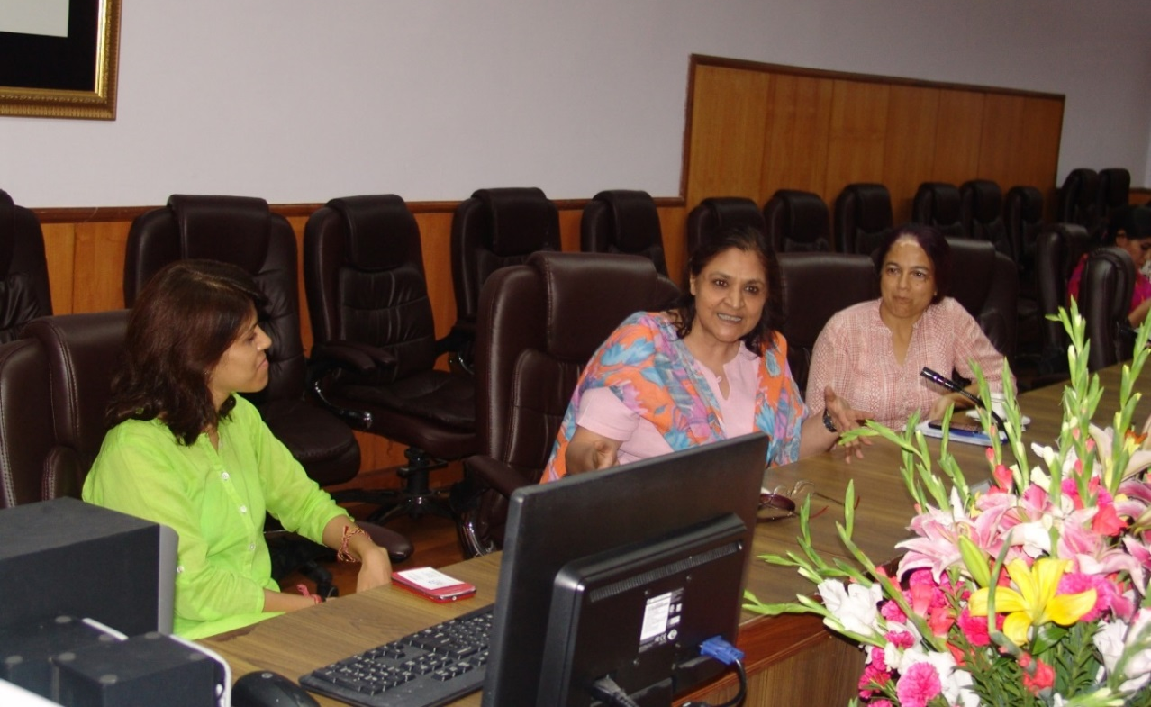
Panel Discussions
Rediscovering Cultural Heritage, Documentation and Mapping as an investigative means
Moderator: Mr. Nikhil Varma
Role of Women in Documenting Diversity and their access to Heritage and
Policy Dialogue
Moderator: Shaguna Gahilote

Slide 21
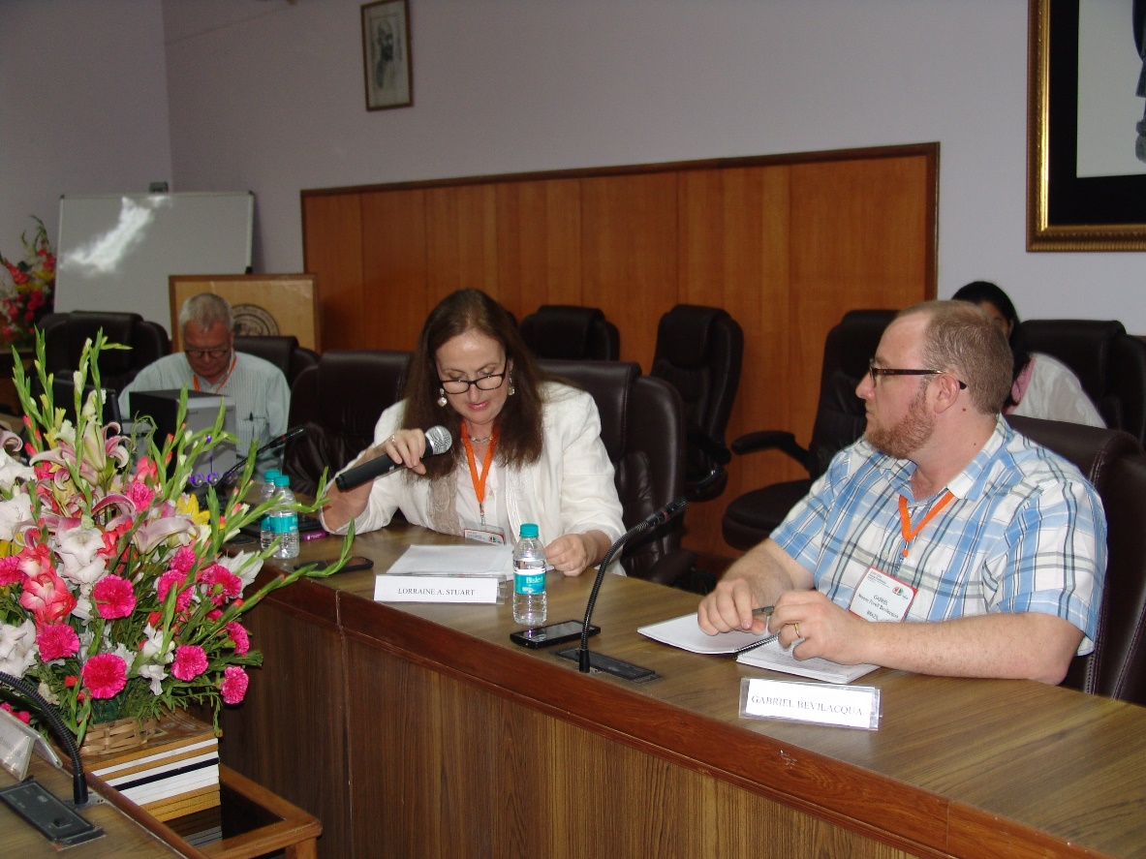

Panel Discussions
How Can We Achieve GLAM? Understanding and Overcoming the Challenges to Integrating Metadata
across Museums, Archives, and Libraries
Moderators: David Farneth and Lorraine A. Stuart
Panelists: Gabriel Moore Forell Bevilacqua, Emanuelle Delmas-Glass, Monika Hagedorn-Saupe, Jennifer Riley, Regine Stein and Remigius Weda

Slide 22
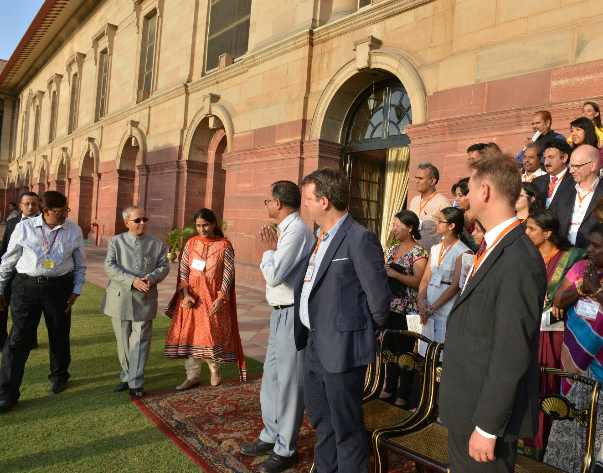
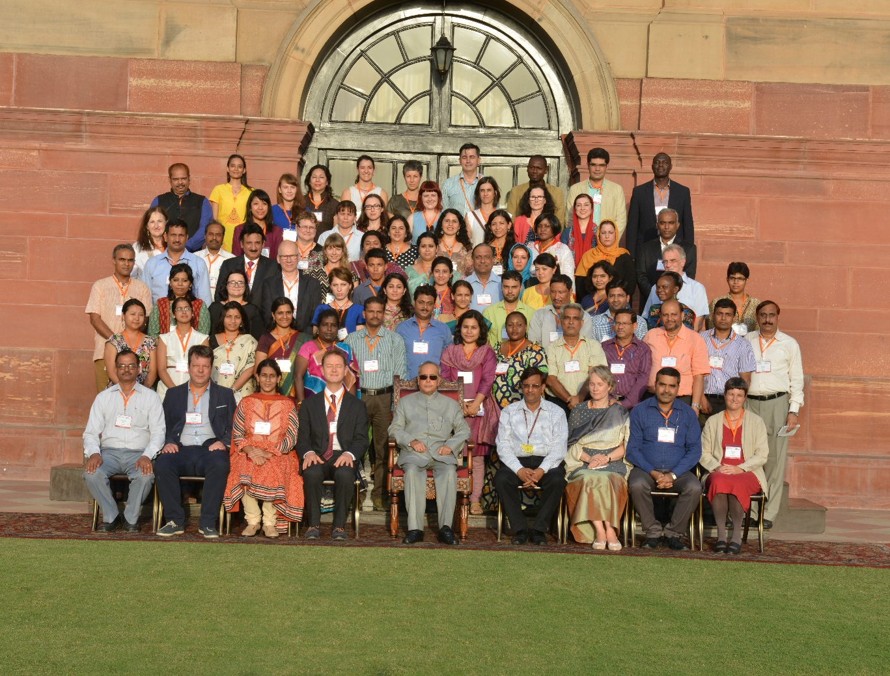
Rashtrapati Bhavan
Visit to the official residence of the President of India

Slide 23
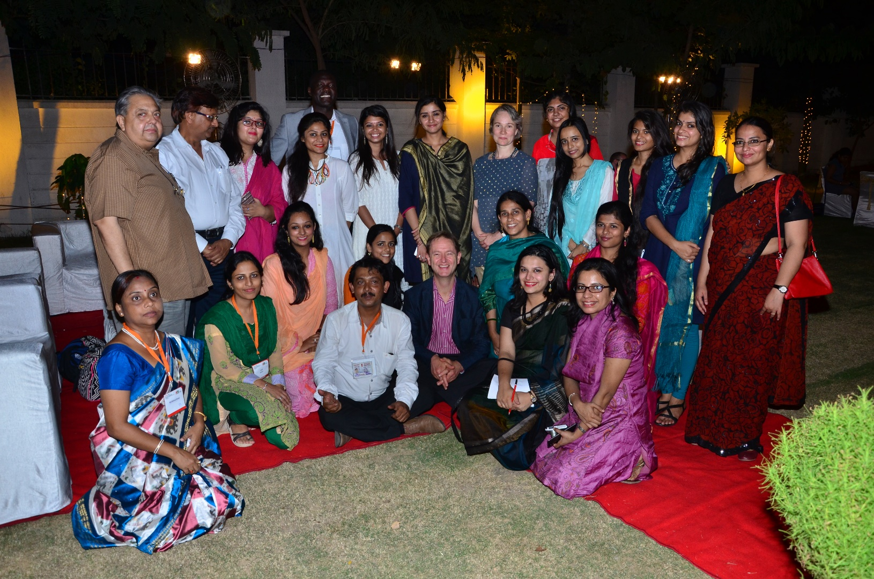
CIDOC 2015
Comité International pour la Documentation
International Committee for Documentation
New Delhi, India
05.09.2015 - 10.09.2015
Documenting Diversity – Collections, Catalogues & Context
Farewell Dinner

Slide 24
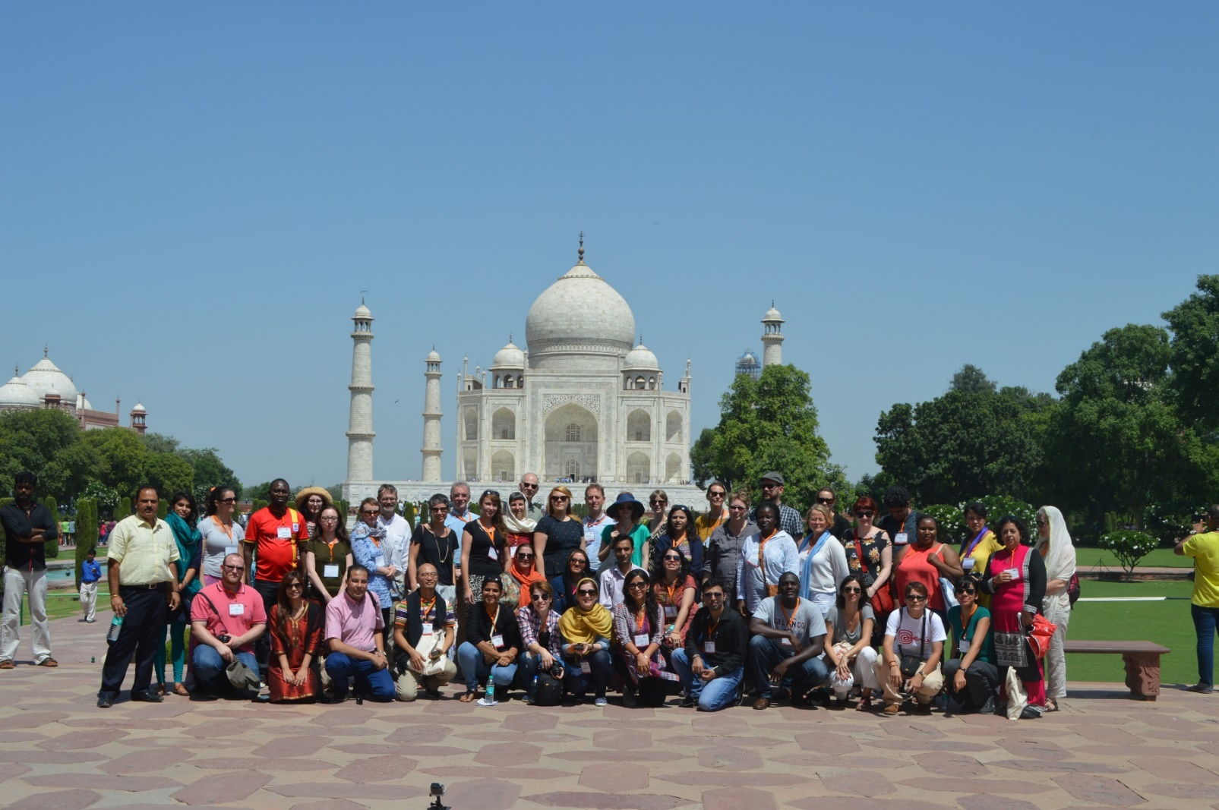
CIDOC 2015
Comité International pour la Documentation
International Committee for Documentation
New Delhi, India
05.09.2015 - 10.09.2015
Documenting Diversity – Collections, Catalogues & Context
Excursion
Excursion: Taj Mahal, Agra

Slide 25
CIDOC 2015
Comité International pour la Documentation
International Committee for Documentation
New Delhi, India
05.09.2015 - 10.09.2015
Documenting Diversity – Collections, Catalogues & Context
Deliberations
Theme: Strategies and policies for documenting the diversity of culture
Special focus on the significance of diversity of context and diverse documentation
needs and challenges of different cultures
Issues of art and its representation, exhibiting new art forms, engaging the community and
initiating dialogue in presenting a broader picture of the heritage / a community
Need of policy for economic and cultural diplomacy in not only unifying the nation, but also
significantly contributing towards an international presence and influence
Documentation of Tangible and Intangible Cultural Heritage as a collective social responsibility
The deviant and respective documentation strategies of institutions at regional level, adopted to
organise their collection in a structured form, stimulating the significance of each object
and preserving the heritage

Slide 26
CIDOC 2015
Comité International pour la Documentation
International Committee for Documentation
New Delhi, India
05.09.2015 - 10.09.2015
Documenting Diversity – Collections, Catalogues & Context
Deliberations
Theme: Strategies and policies for documenting the diversity of culture
Strategies for preserving textual heritage in the digital domain in developing economies
Records management through online database
Creating a national heritage inventory and Capacity building of staff in identifying and inventorying diverse forms of Intangible Cultural Heritage for posterity through using a collaborative community approach
Capacity-building through multidirectional collaborations involving various knowledge- holders-local and international-modern communication and digital technology transfer
Adopting strategies on national and institutional levels in order to support digitisation, interoperability and harmonisation of data on an infrastructure level

Slide 27
CIDOC 2015
Comité International pour la Documentation
International Committee for Documentation
New Delhi, India
05.09.2015 - 10.09.2015
Documenting Diversity – Collections, Catalogues & Context
Discussions and Deliberations
Theme: Strategies and policies for documenting the diversity of culture
Influence of museum strategies on the educational function and knowledge management, on the basis of documentation and customer orientation
Challenges in the documentation of sacred ethnographic objects
Barriers of implementing an Open Access System
Museum documentation with community involvement
Documenting the advantages of the collaboration between museum, academia and communities
Problems and challenges of preservation of artists’ legacy in India
Prospects and constrains in digital documentation of Manuscripts

Slide 28
CIDOC 2015
Comité International pour la Documentation
International Committee for Documentation
New Delhi, India
05.09.2015 - 10.09.2015
Documenting Diversity – Collections, Catalogues & Context
Discussions and Deliberations
Theme: Techniques and Methods of Documentation
Methods and techniques for creating modes of documentation for traditional and digital media environments – challenges and experiences
Documenting indigenous perception through children’s drawing
Understanding Archaeology through museums
Digitisation of Intangible Cultural Heritage
Risk of copyright infringement
Documenting and preserving the endangered archives
Problems and prospects in documenting the traditional knowledge systems with respect to the preservation of manuscripts

Slide 29
CIDOC 2015
Comité International pour la Documentation
International Committee for Documentation
New Delhi, India
05.09.2015 - 10.09.2015
Documenting Diversity – Collections, Catalogues & Context
Discussions and Deliberations
Theme: Techniques and Methods of Documentation
Story telling with museum objects
Need of scientific documentation of Modern and Contemporary Artworks
Methods for documentation and exhibition of Urban Built Heritage
3D Documentation of Archaeological Sites
Issues of the preservation management of the sports documentation
Mapping of Cultural Heritage
Documenting the role of community museums in inter-cultural dialogue
Close-range 3D imaging for documenting and monitoring dynamic deterioration processes in wall paintings

Slide 30
CIDOC 2015
Comité International pour la Documentation
International Committee for Documentation
New Delhi, India
05.09.2015 - 10.09.2015
Documenting Diversity – Collections, Catalogues & Context
Discussions and Deliberations
Theme: Techniques and Methods of Documentation
Capacity building in re-organisation of storage and implementation of documentation system
Documentation practice of the intangible ethnographic heritage through tangible artefacts
Issues involved in documenting a social history collection
Role of community in documenting and presenting cultural diversity
Ways to source data for natural history specimen in different contextual settings with community involvement
Importance of ritual and festive performance, and the issues involved in documenting ethnic festivals
Documentation in National Museums
Documentation of Natural History Collection

Slide 31
CIDOC 2015
Comité International pour la Documentation
International Committee for Documentation
New Delhi, India
05.09.2015 - 10.09.2015
Documenting Diversity – Collections, Catalogues & Context
Discussions and Deliberations
Theme: Techniques and Methods of Documentation
Collection, Documentation and Management of Anthropological Museums
Documentation of Textiles and Costumes in Museums
Documenting and Revitalizing Dying Communities
Scope of Authenticity in Recording Oral Traditions
Access to Online Museum Content through controlled vocabularies
The future of classical museums in virtual form

Slide 32
CIDOC 2015
Comité International pour la Documentation
International Committee for Documentation
New Delhi, India
05.09.2015 - 10.09.2015
Documenting Diversity – Collections, Catalogues & Context
Discussions and Deliberations
Theme: Access and Integration – Working together with Archives and other Heritage
Institutions
Studying and Documenting Art, and Exhibiting Diversity
Initiatives towards the Integrated Data Management in the Archaeological Site Museums of Archaeological Survey of India
Archiving Hindu Sacred Places in India
Evolution of the idea of Heritage and its documentation
Documenting Church Archives in India
The Importance of Oral Tradition in Bridging the Rural and the Commercial
Preservation and Documentation of maritime archaeological findings recovered from marine environment in India

Slide 33
CIDOC 2015
Comité International pour la Documentation
International Committee for Documentation
New Delhi, India
05.09.2015 - 10.09.2015
Documenting Diversity – Collections, Catalogues & Context
Deliberations and Discussions
Theme: Access and Integration – Working together with Archives and other Heritage
Institutions
Development of integrated work for the collection’s research, preservation and communication in museums and archives
Cross Linking and access to buildings Documentation by Colleges, National Student
Bodies and Government Archives
Partnering to Manage and Integrate Access across museum and archival collection
Telling stories with Museum Objects
Storytelling: Interaction, Methods & Interpretation
Documentation, Data Analysis, & Interpretation using digital application in cave architecture in India

Slide 34
CIDOC 2015
Comité International pour la Documentation
International Committee for Documentation
New Delhi, India
05.09.2015 - 10.09.2015
Documenting Diversity – Collections, Catalogues & Context
Deliberations and Discussions
Theme: Access and Integration – Working together with Archives and other Heritage
Institutions
Documenting museum collection through digital media
The changing role and function of synagogues remodelled as museums in Cochin, Kerala
Collaboration between archives and cultural institutions
Documenting Diversity in Traditional Clothing as reflected in Museum Collections
Copyright in the Digital Era: Access to Archival Sources
Interconnecting Archival and Field Data to Understand Cultural Biography of Monuments
Aggregating Free Access to Digitized Images and Counting

Slide 35
CIDOC 2015
Comité International pour la Documentation
International Committee for Documentation
New Delhi, India
05.09.2015 - 10.09.2015
Documenting Diversity – Collections, Catalogues & Context
Deliberations and Discussions
Theme: Access and Integration – Working together with Archives and other Heritage
Institutions
Recording, Documenting, Researching, and Exhibiting Local Cultural Heritage with Community Participation
Exploring Integrated Approaches to re-assess and authenticate museum documentation
Integration of heritage institutions on a national level
Literary Heritage Preservation
Integrating Archival Studies with Architectural Research
Documenting Visual Traditions in preserving Indic Heritage
Documenting personal collections
Architectural Documentation of Sites and Structures

Slide 36
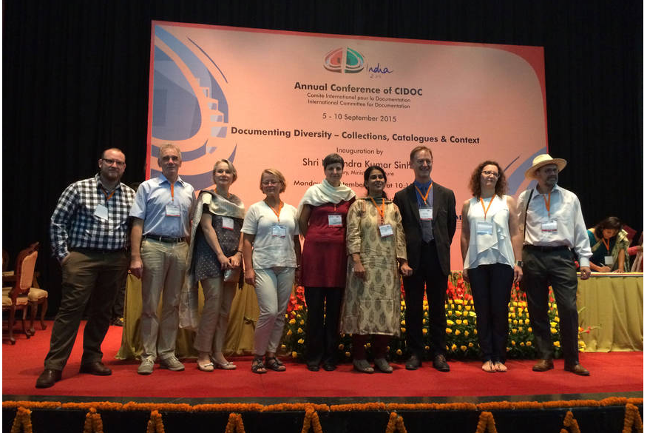
CIDOC 2015
Comité International pour la Documentation
International Committee for Documentation
New Delhi, India
05.09.2015 - 10.09.2015
Documenting Diversity – Collections, Catalogues & Context
CIDOC 2015

Slide 37
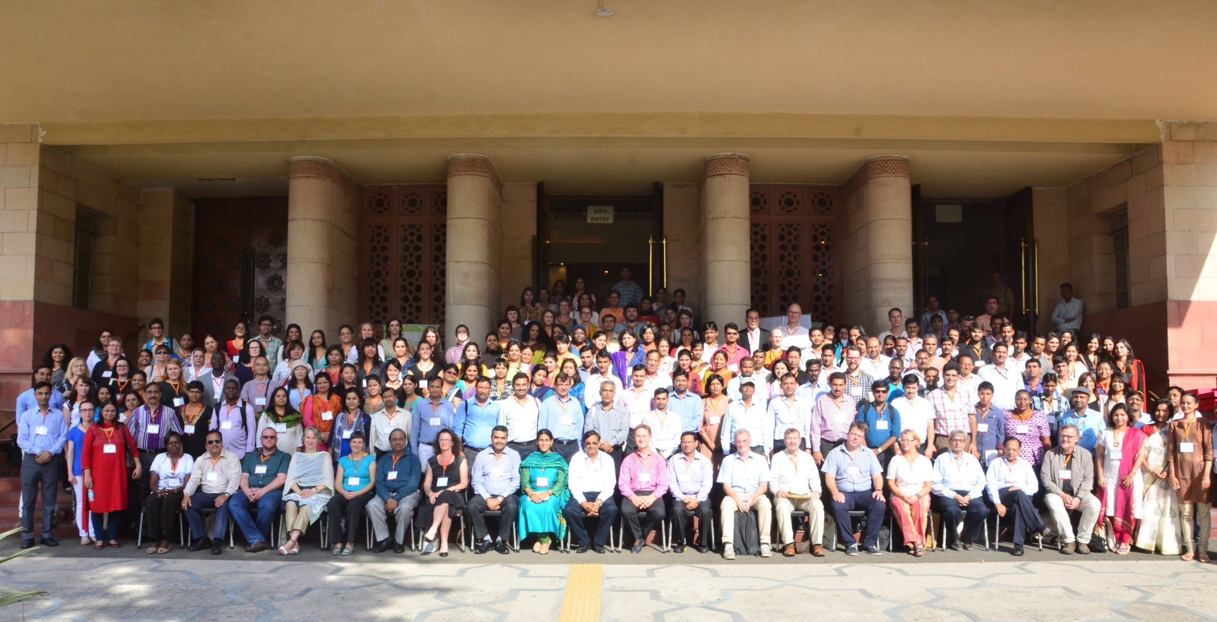
CIDOC 2015
Comité International pour la Documentation
International Committee for Documentation
New Delhi, India
05.09.2015 - 10.09.2015
Documenting Diversity – Collections, Catalogues & Context
CIDOC 2015
Conference Delegates

