Slide 1


CIDOC
LIDO Working Group
Notes:
This year’s meetings took place
- on Sunday 03.07.2016 as a full-day meeting with 15 attendees,
We also run a LIDO introductory meeting on Monday 04.07.2016.

Slide 2
Working Group Meeting 03/07/2016
Implementing LIDO - a new LIDO booklet (Gordon McKenna)
The Common Catalogue of Data Fields for Prints and Drawings. A Guide to High-Quality LIDO Data (Angela Kailus)
Towards Complexity. Two Case Studies to the Enriched LIDO-based Description of Objects - the Context of the 19th Century Ornamental Prints and of the Plaster Casts: (Julia Katona)

Slide 3
Work on LIDO Terminology
  Formalize recommendations for the use of schema elements with schema refining character („type“ elements and attributes)
  Provide best-practice examples
  Aims to support
    Data production / indexing
    Consistent mapping
    Portal functions – refined access
    LOD publication

Slide 4
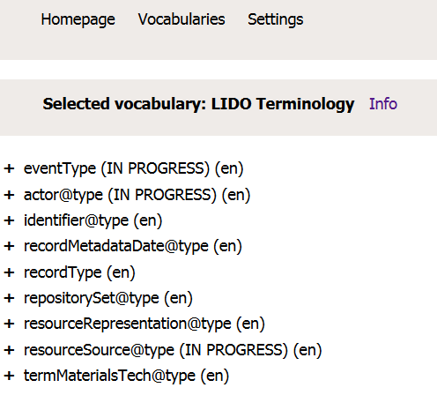
  First set of recommendations ready for publication
  Results of Call for Review and WG meeting to be included and published on LIDO webpage by end of July
  Work going on with further LIDO elements / attributes

Slide 5
LIDO Working Group
http://network.icom.museum/cidoc/working-groups/lido/
Contacts:
Regine Stein (r.stein@fotomarburg.de)
Erin Coburn (erinshanecoburn@gmail.com)
Emmanuelle Delmas-Glass (emmanuelle.delmas-glass@yale.edu)

