Slide 1
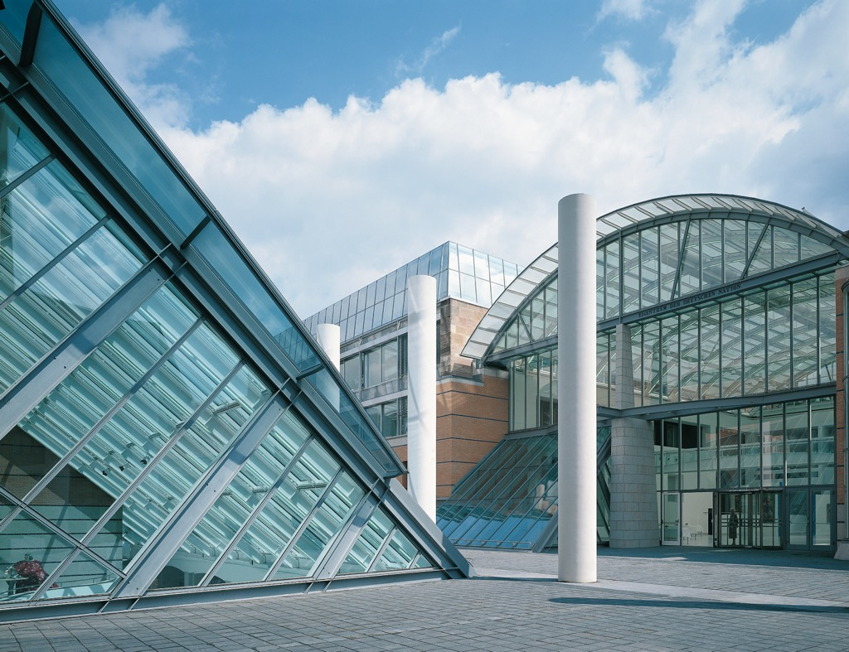

1
Thema der Präsentation

Slide 2

WissKI
Wissenschaftliche KommunikationsInfrastruktur
Scientific
Communication Infrastructure
An Architecture for a Virtual Research Environment
Architektur einer virtuellen Forschungsumgebung
WissKI Workshop
ICOM - Milano 2016
Siegfried Krause - Germanisches Nationalmuseum
WissKI – Wissenschaftliche KommunikationsInfrastruktur

Slide 3




The WissKI Team
Project Application: Spring 2008
accepted by
Fall 2008
Funded from 2009 - 2011 & 2014 - 2016
WissKI – Wissenschaftliche KommunikationsInfrastruktur

Slide 4
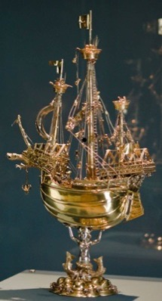
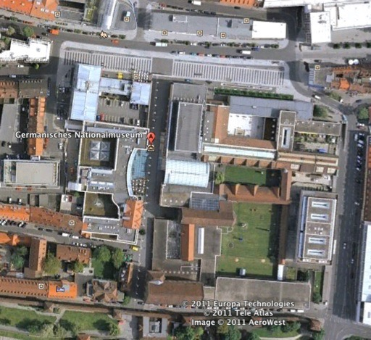
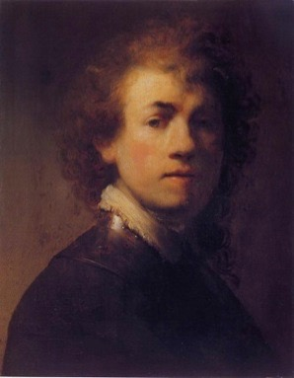

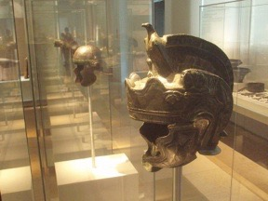
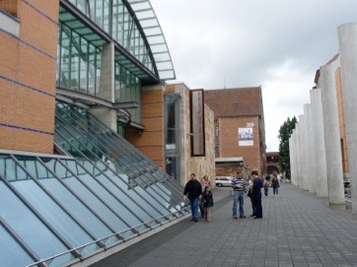
A short „unguided“ Museum Tour
The Mission of the GNM:
Collecting all kind of Objects of German Art, Culture and History
WissKI – Wissenschaftliche KommunikationsInfrastruktur

Slide 5
The Museum consists of...
a Library
  about 600.000 Books, 6000 ancient Manuscripts
a Historical Archive
  15.000 Autographers
The German Artist Archive
  two and a half kilometers
16 Museum Research Departments
  Painting, Sculpture, Archaeology etc.
WissKI – Wissenschaftliche KommunikationsInfrastruktur

Slide 6
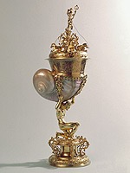
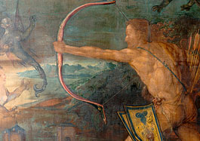
A cornucopia of Projects
Nuremberg Goldsmith
research project at the Germanisches Nationalmuseum (1997-2005)
The Early Dürer Research Project at the Germanisches Nationalmuseum (2009-2012)
WissKI – Wissenschaftliche KommunikationsInfrastruktur
Notes:
difficulty of data management with research projects

Slide 7
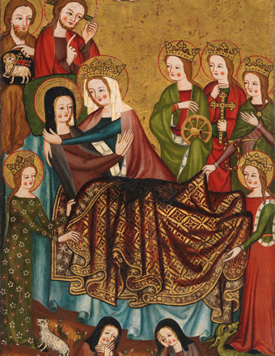
A cornucopia of Projects
GERMAN PANEL PAINTING
OF THE LATE MIDDLE AGES
Examination of the paintings
at the Germanisches nationalmuseum
from the perspective of art history
and art technology
2013 - 2018
THE COLLECTION OF MUSICAL INSTRUMENTS - RÜCK AS AN EXAMPLE
2015 - 2018
WissKI – Wissenschaftliche KommunikationsInfrastruktur
Notes:
Project duration: 2013-16 Project sponsorship: Leibniz Association An extensive research project, sponsored by the Leibniz Association, on German panel painting of the late Middle Ages launched the Germanisches Nationalmuseum in April 2013. The goal is the scientific examination of the museum's holdings of around 250 paintings from the 13th to the 15th century. The collection is one of the largest and most important of its kind. The initial phase of the project concentrates on Franconian paintings.
The paintings are being investigated by a research team of art historians and experts in art technology. The team studies each work's technique and historical context, as well as changes of the original appearance that have resulted from ageing and reworkings. The artistic features, iconography and traditions of representation are also scrutinised. On the basis of this new information, it is possible to critically view and correct the previous art-historical classification of each painting in terms of dating, regional designation and attribution to an artist. The clarification of acquisition history, provenance and original location provides an insight into the former purpose of the works, which today are removed from their functional context. The interdisciplinary approach to these works yields new information on the role of the images as bearers of meaning, on religious practices in the late Middle Ages and on production conditions in workshops of the time.
The project is making an important contribution to research on painting in the German-speaking reagions prior to 1500 and will provide a new basis for future scholarship. The results will be published in a collection catalogue. The first volume, on the museum's Franconian paintings, is scheduled to appear in 2017. A supplementary online presentation is also planned.
Basic research using the correspondence
The correspondence archive of the Rück Collection offers unique and fascinating insights into the structure and function of one of the largest private collections in Germany. The items of correspondence preserved in the GNM's Historical Archive today enable us to determine the presumably representative purchase prices for most of the musical instruments acquired between 1930 and 1962 - and in conjunction with the musical instruments preserved in the GNM, to compile a price overview for the trade in historic musical instruments at that time. All items of correspondence will be digitalized at the start of the project, not least for reasons of conservation. In addition to determining and documenting the acquisition transactions and related provenances, the project will examine in detail this example of a strategy for establishing a subject-oriented European network with the aim of setting up an important musical instrument collection and will be the first detailed documentation of the history of this remarkable private collection. The acquisition data will be made accessible on-line in a WissKI database.

Slide 8
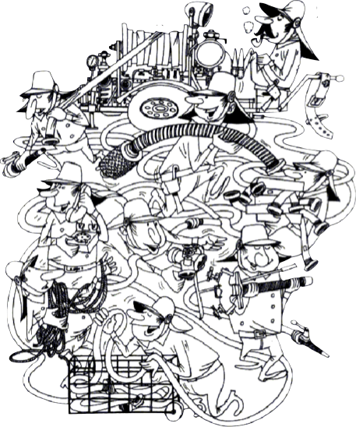
Using fantastic Technologies...
Project Teams created confusing workspaces
WissKI – Wissenschaftliche KommunikationsInfrastruktur

Slide 9
What did those Workspaces or Data Silos contain...?
Scholarly collections of primary data of objects, architecture, cultural environments etc.
Scholarly opinions on (museum) objects
Various scholarly statements & beliefs
Scholarly classifications, taxonomies
WissKI – Wissenschaftliche KommunikationsInfrastruktur

Slide 10
Additional Observations
Projects create data silos mainly for publication purposes.
These data silos contain much more information than it is ever published. What happens to the unused Information?
While data silos containing information for a group of researchers they are in many cases individually organised.
Data silos are considered by curators to be valuable sources even after the project has finished. Therefore data silos should be archived.
WissKI – Wissenschaftliche KommunikationsInfrastruktur

Slide 11
But ...
What means archiving an individually organised data silo for further reuse?
WissKI – Wissenschaftliche KommunikationsInfrastruktur

Slide 12
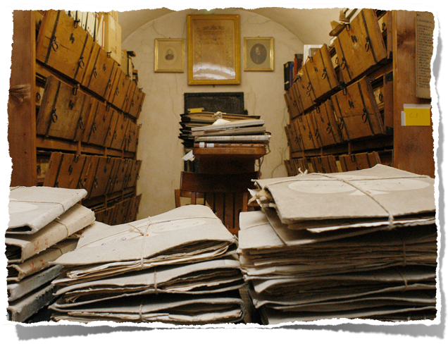
20 years ago - it was so easy ...
WissKI – Wissenschaftliche KommunikationsInfrastruktur

Slide 13
But today - Things might be more difficult ...

Slide 14
Turning such a Data-Silo to a "living" Archive one should use ..
standardised technical formats
standardised logical formats
controlled vocabularies (global/local)
well documented data & structures
well defined & well documented data policies
WissKI – Wissenschaftliche KommunikationsInfrastruktur

Slide 15
There exists one Challenge!
Museum Curators and Researchers can easily do without any kind of formalisation/normalisation!
WissKI – Wissenschaftliche KommunikationsInfrastruktur
Notes:
On the contrary - they understand such procedures as a danger, which takes their individualism away and it is very hard in cultural area to convince people to go that way.

Slide 16

But how to convince them?
As far as possible,
the scientific user should not get in contact with technological obstacles!
The system should ease the work with controlled vocabularies
The system should reflect the intelectuall workflow
of the researcher
WissKI – Wissenschaftliche KommunikationsInfrastruktur

Slide 17
The WissKI Solution
Scientific Communication Infrastructure
Wissenschaftliche KommunikationsInfrastruktur
An Architecture for a Transdisciplinary Virtual Research Environment (VRE)
http://wiss-ki.eu/
WissKI – Wissenschaftliche KommunikationsInfrastruktur
Notes:
The goal of the WissKI project is to apply the concept of Wikis to the scientific domain and to support transdisciplinary collaboration between scientists and researchers from various domains, enabling them to learn about results of research and work together on research topics of common interest. In general, the system supports scientific communication and a new way of documentation in memory institutions, provides long-term availability of research results, assures the identity of authorship and the authenticity of information, enables the persistence of citations, offers quality management tools, and support the preparation of scientific publication. Scientific knowledge can be communicated using the platform, where it is stored and can be reused to follow scientific discussions and to prepare publications.

Slide 18
Requirements
Supporting reuse of research data and of the gained knowledge
Assisting researchers throughout the scholarly processing cycle: data acquisition, analysis, knowledge generation
Supporting research collaboration/communication on a transdisciplinary scale
WissKI – Wissenschaftliche KommunikationsInfrastruktur

Slide 19
Requirements
Providing long-term availability of research results
Assuring the identity of authorship and the authenticity of information
Supporting the preparation of scientific publications
WissKI – Wissenschaftliche KommunikationsInfrastruktur

Slide 20
Semantic Implementation Objectives
Conditioning & augmentation by metadata of digital primary sources (e.g. digital object catalogues)
Semantic modelling & annotation (annotated linked sources)
Semantic enrichment by formal ontologies & semantic dictionaries, vocabularies
Federation with data from other sources (e.g. integrating Information between natural history and cultural history)
WissKI – Wissenschaftliche KommunikationsInfrastruktur

Slide 21
WissKI has two UIs
Data Entry User Interface
Data Entry User Interface is both - it is formular/field based and offers in the same time fulltext capabilities
Presentation/Communication UI
The WissKI presentation/communication user interface applies the concept of Wikis.
WissKI – Wissenschaftliche KommunikationsInfrastruktur

Slide 22
General Technical Issues
Wisski is based completely on Open Source technology
WissKI is build on a LAMP Web-Stack
WissKI modules are programmed in PHP
WissKI modules are embedded in a CMS (Drupal)
WissKI – Wissenschaftliche KommunikationsInfrastruktur

Slide 23
Semantic / technological Issues
WissKI uses MySQl/Arc2 as a Triple store
WissKI uses as semantic standard technologies: CIDOC-CRM, OWL, XML/RDF, SPARQL
WissKI supports standard formats for Import/Export like SKOS, LIDO and RDF
WissKI supports the OAI protocol for providing metadata
WissKI – Wissenschaftliche KommunikationsInfrastruktur

Slide 24
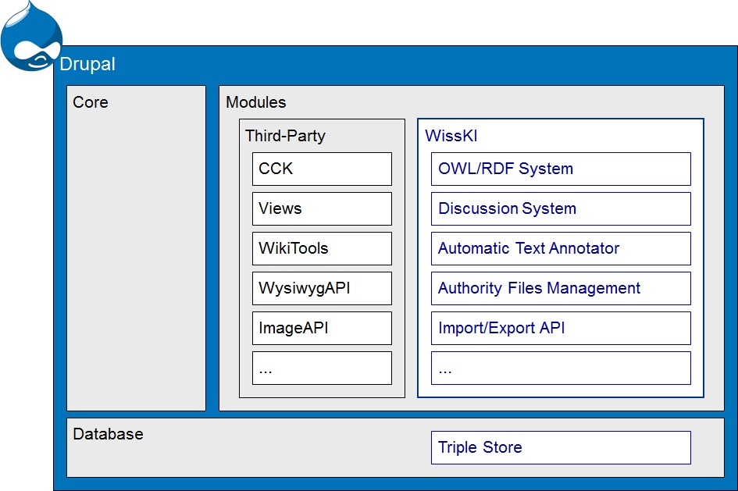
Software Infrastructure
The WissKI Stack
WissKI – Wissenschaftliche KommunikationsInfrastruktur

Slide 25
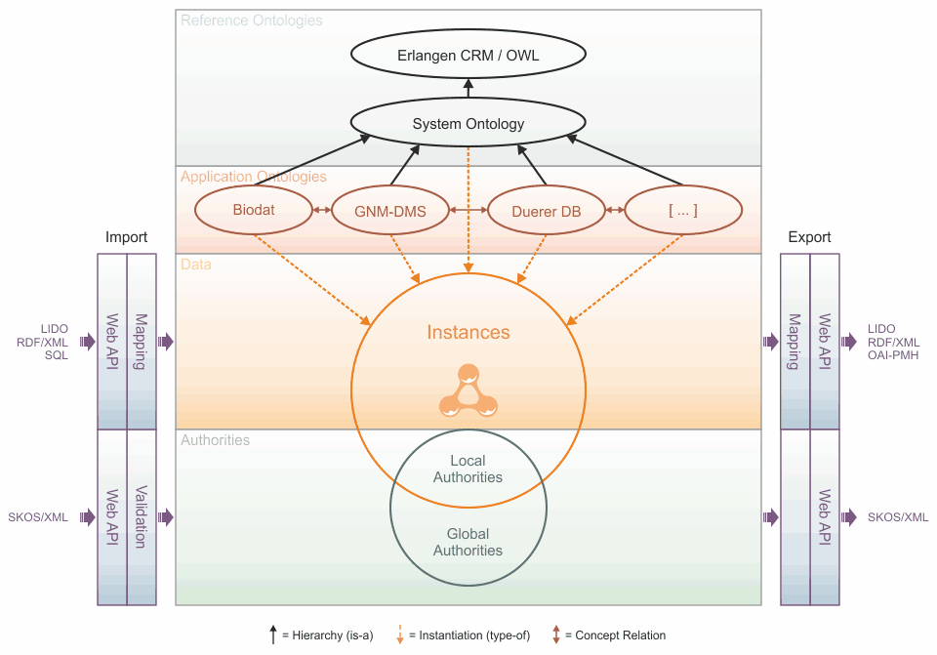
System Architecture
WissKI – Wissenschaftliche KommunikationsInfrastruktur
Notes:
Reference Ontology
# Ontologies in computer science are normally based on formal logics with well founded semantics # Ontologies consisting of concepts and properties and instances of them
System Ontology
# Since the CRM/ECRM is an upper ontology, most concepts have an abstract character (e.g. E22 Man-Made-Object). # The System Ontology extends the ECRM and provides more specialised concepts where the CRM is not specific enough for an implementation.

Slide 26





Local Knowledge Integration
Application Ontology
The Earl Dūrer
Application Ontology
Goldsmith Marks of Nūrnberg
Application Ontology
Mythos Burg
Application Ontology
future projects
WissKI – Wissenschaftliche KommunikationsInfrastruktur

Slide 27




Global Knowledge Integration
Creating Inter-WissKIs
transdisciplinary & over-institutional via Internet
WissKI – Wissenschaftliche KommunikationsInfrastruktur

Slide 28
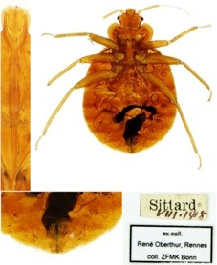
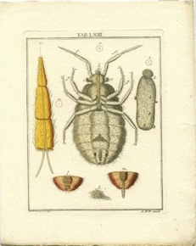
Transdisciplinary Documentation of a bed bug at the GNM and at the ZFMK Cimex lectuarius Linnaeus, 1758
Katalog Nr.: | ZFMK_HET_2007_200
Determination: | Cimex lectuarius Linnaeus, 1758
Determinator: | Dirk Rohwedder, 2007
Fundort: | Sittard
geo. Koordinaten: | 51 ° 00’ 00’’ N / 5° 52’ 0’’ E
Sammler: | Rene Oberthür
Sammeldatum: | VIII. 1918
Ehemalige Sammlung: | Rene Oberthür
Inventarnummer: | HB Kapsel
Allg. Bezeichnung: | Darstellung eines mikroskopischen Befundes (Insekt)
Hersteller: | Winterschmidt, Adam Wolfgang (Verleger); Ledermüller, Martin Frobenius (Zeichner)
Datierung: | um 1750
Herstellungsort: | Nürnberg? (Verlagsort)
Material/Technik: | Papier / Kupferstich & handkoloriert
Maße: | ,9 x ,1 (Platte) & ,5 x ,3 (Darstellung) & ,9 x ,8 (Blatt) (Höhe*Breite/cm)
Schlagwort: | Mikroskop, Thema eines naturwissenschaftlichen Experiments; Insekten
WissKI – Wissenschaftliche KommunikationsInfrastruktur

Slide 29

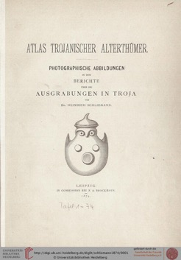
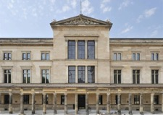

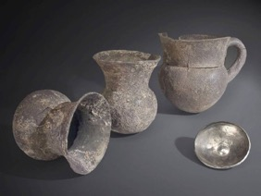
Information Integration
The „New Museum“ in Berlin
Silvervessels / Part of the Treasury of Priamos/Troy
Digitized Report of the Excavations in Troy at the University Library in Heidelberg
WissKI – Wissenschaftliche KommunikationsInfrastruktur

Slide 30
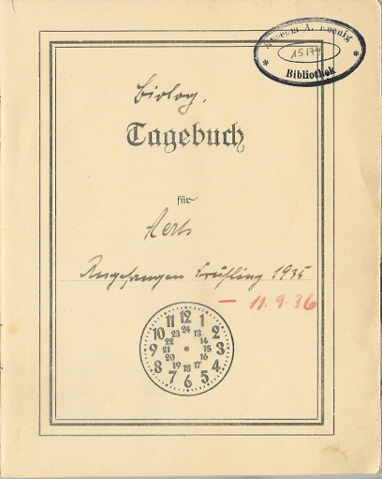
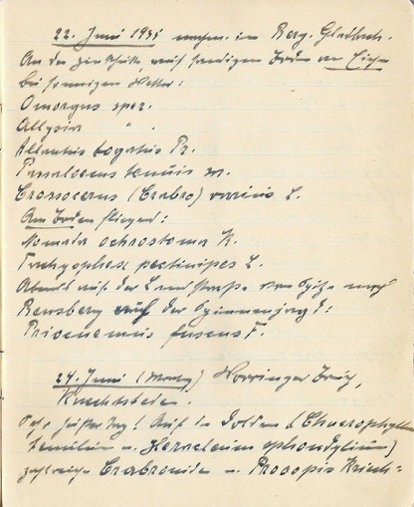
Synchronising Expedition Itineraries with collected Objects
WissKI – Wissenschaftliche KommunikationsInfrastruktur

Slide 31
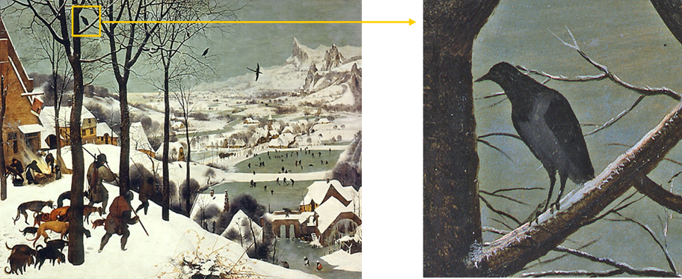
Climatic Change
Hunters in the Snow
(P. Breughel the Elder, 1565, KHM Wien: Inv. No.GG1838)
WissKI – Wissenschaftliche KommunikationsInfrastruktur
Notes:
Hooded Crows in the Netherlands
Climatic change in the 16. century a period which was called the Small Ice Age.
Today hooded crows will be found only east of the river Elbe or in Scandinavia

Slide 32
WissKI is more than museum documentation
WissKI was originally motivated by the needs of museum documentation, object-based research and interoperability
But WissKI does much more:
it proposes
A general design and implementation of a prototypical system architecture for a Virtual Research Environment.
WissKI – Wissenschaftliche KommunikationsInfrastruktur

Slide 33
WissKI Wrap-Up
WissKI offers you the freedom to create a data structure which are completely driven by the needs of your project
WissKI allows you to use most available sources of authorities (Local & global sources)
All links between data are created automatically
WissKI supports only standardised technologies
WissKI projects can reuse the results of other WissKI projects both on an institutional or on a global level
WissKI – Wissenschaftliche KommunikationsInfrastruktur

Slide 34
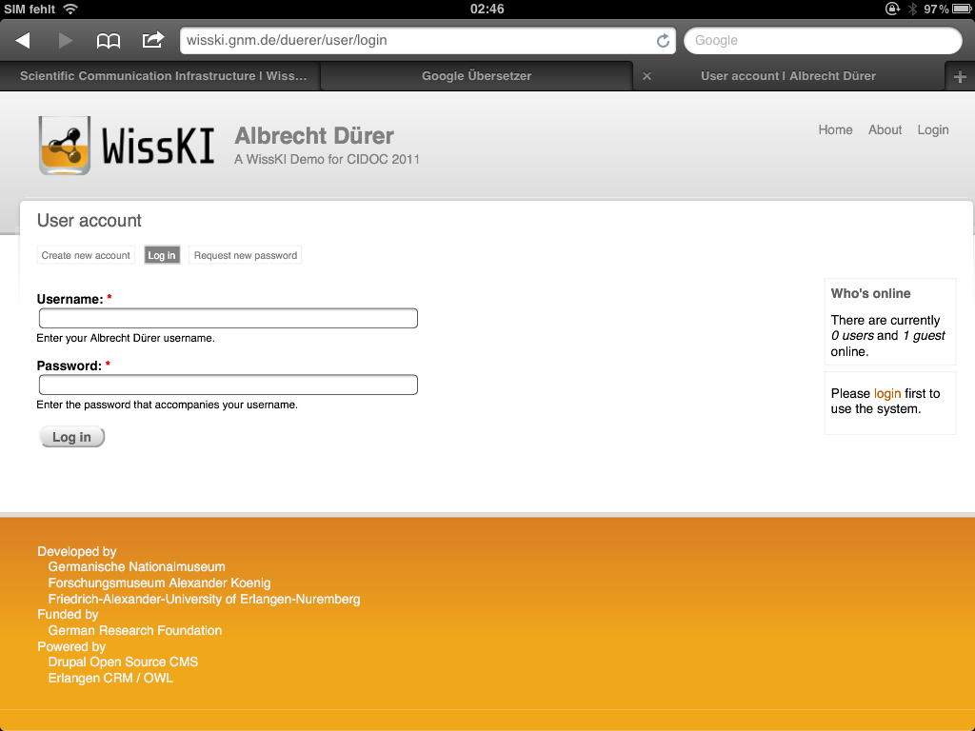

Slide 35
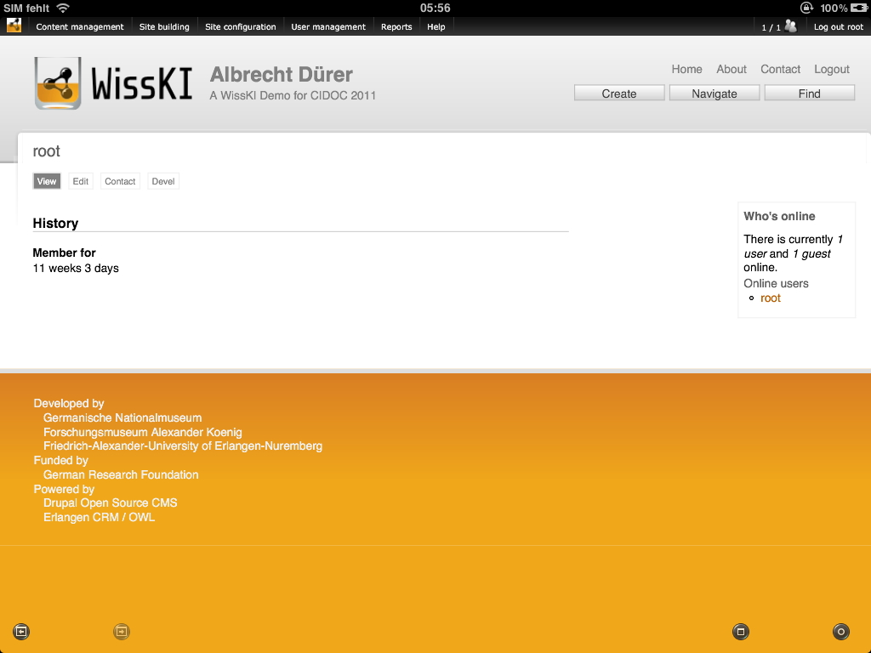

Slide 36
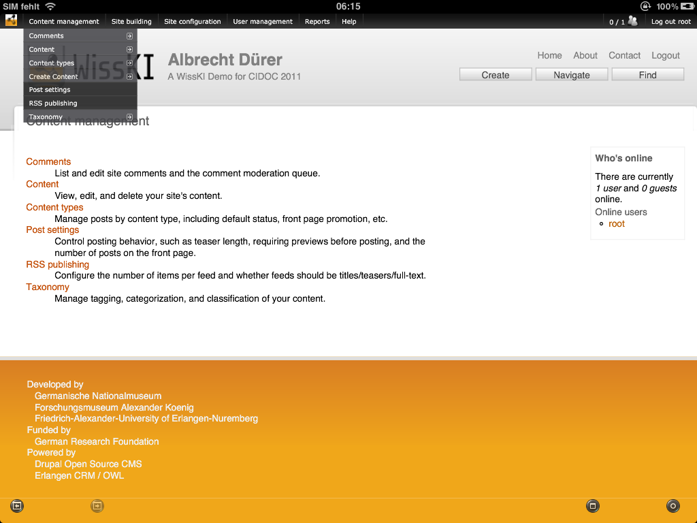

Slide 37
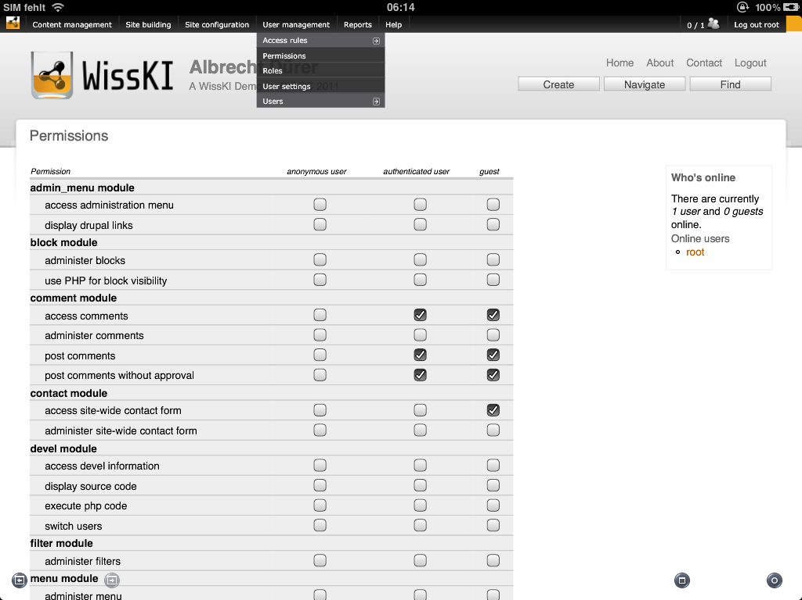

Slide 38
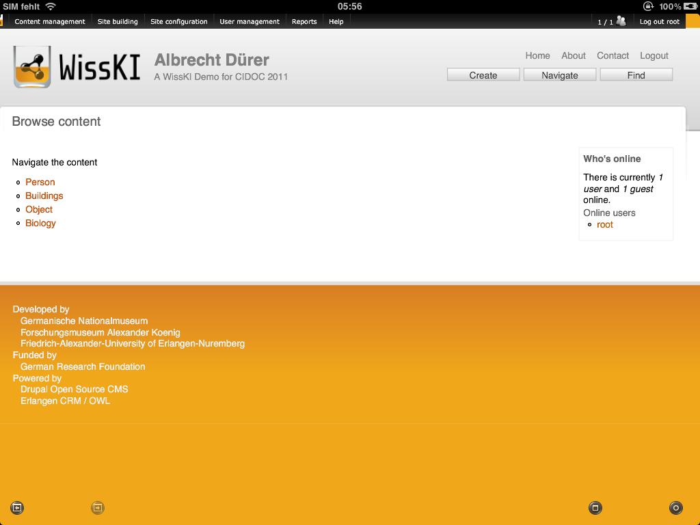

Slide 39
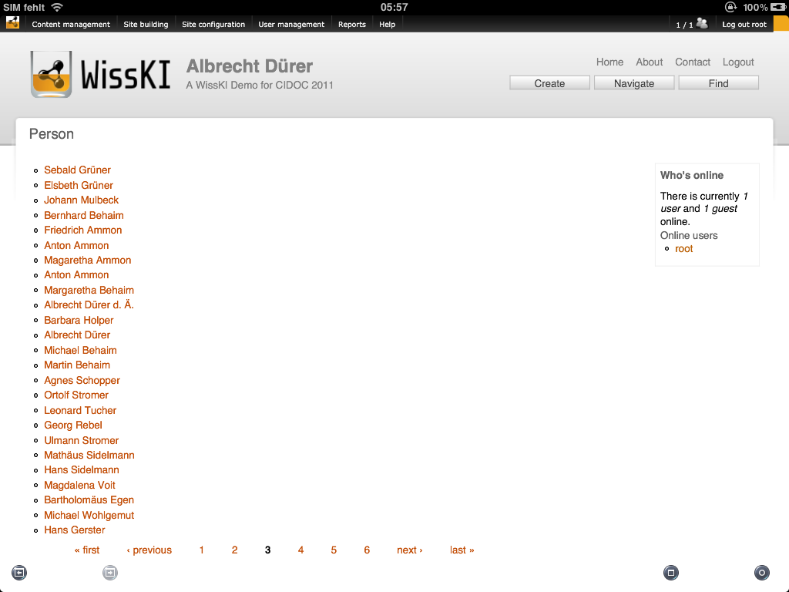

Slide 40
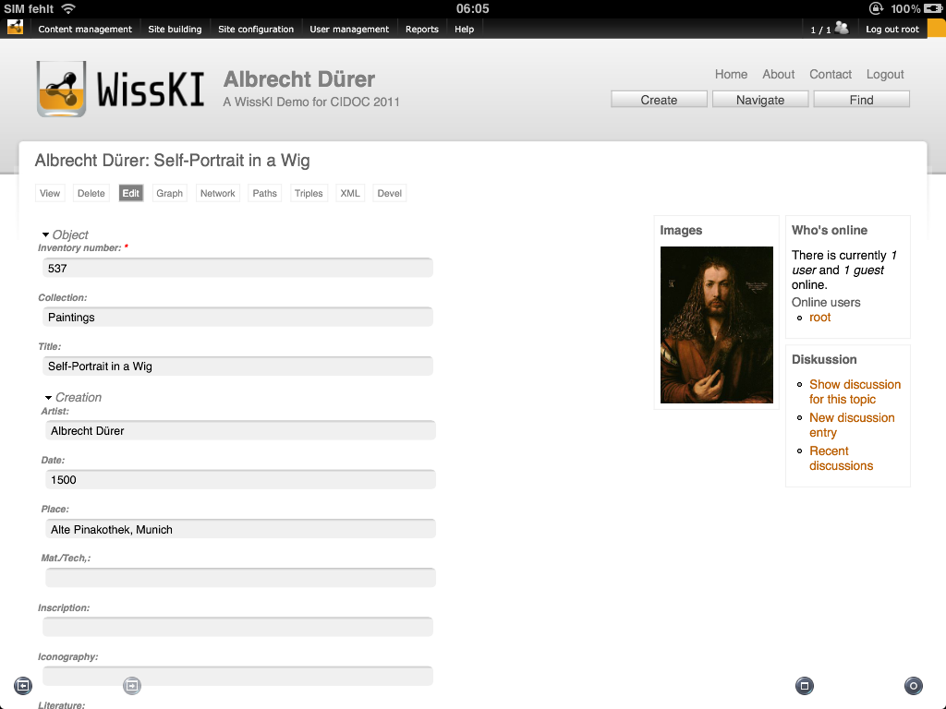

Slide 41
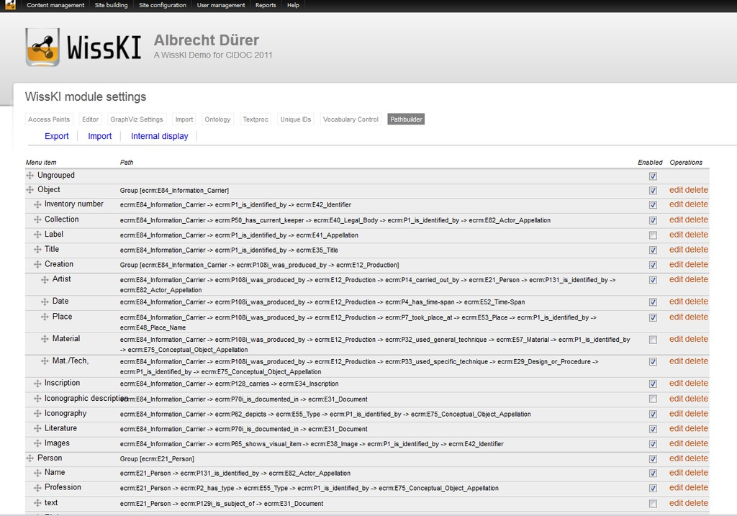

Slide 42
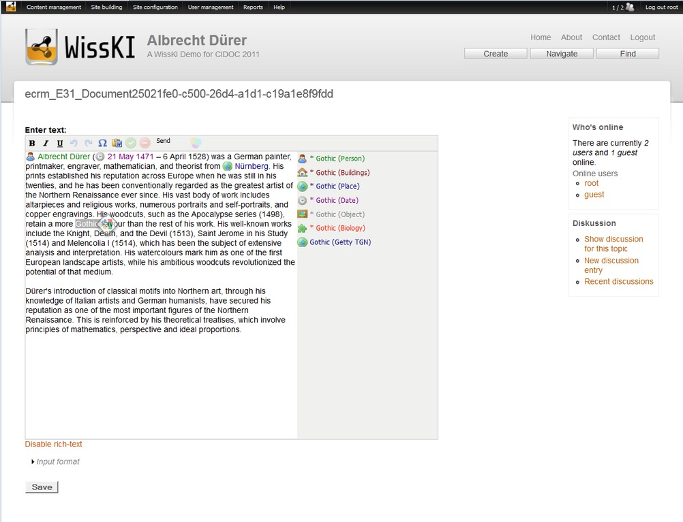

Slide 43
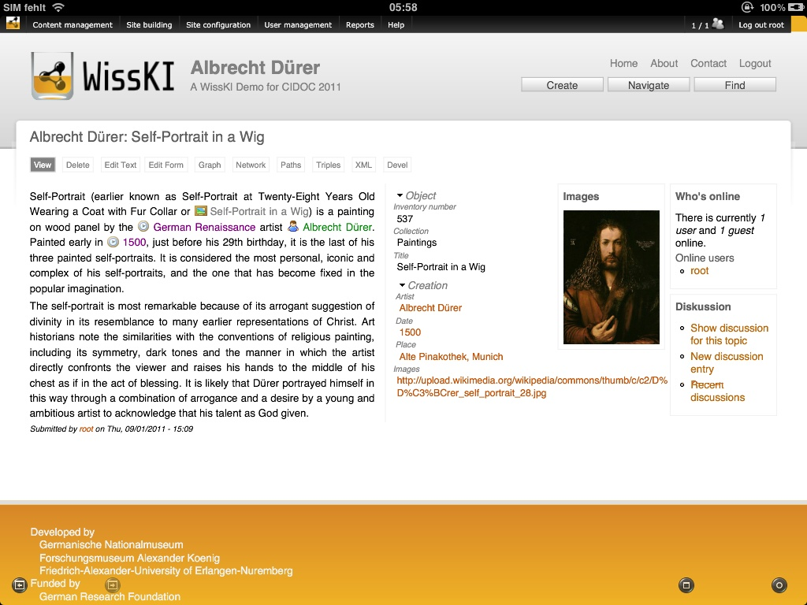

Slide 44
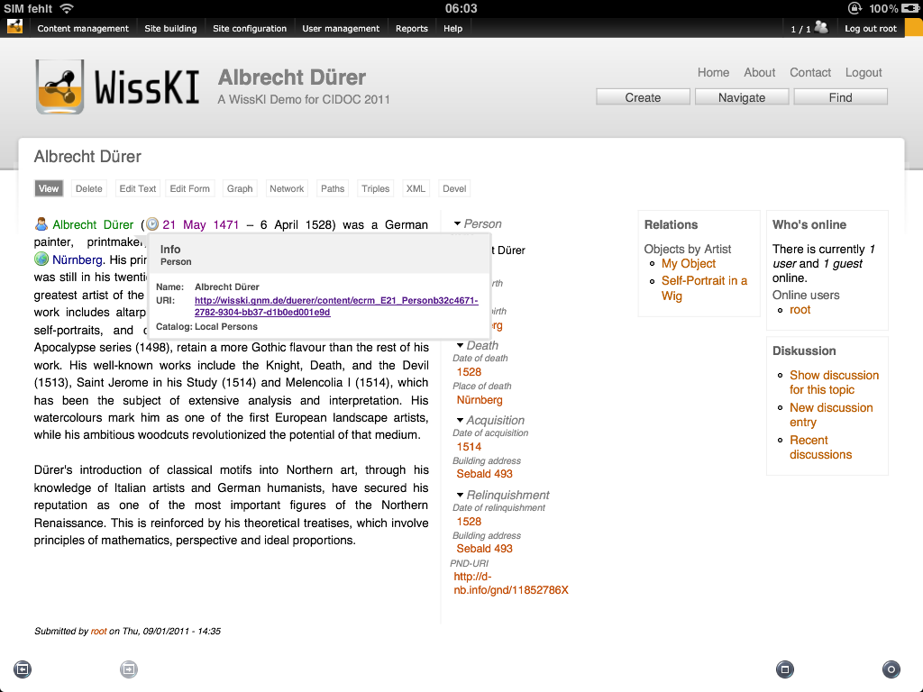

Slide 45
