Slide 1
Annual report and current focus
CIDOC CRM SIG
CIDOC Annual General Meeting
Milan, 6th July 2016

Slide 2
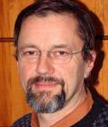
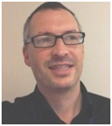
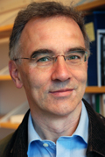
CIDOC CRM SIG People
Chair
  Martin Doerr FORTH, Greece
Deputy-chairs
  Dominic Oldman, British Museum, UK
  Christian-Emil Ore, Univ. of Oslo, Norway
More than 100 members
  See http://cidoc-crm.org/special_interest_members.html

Slide 3




CIDOC CRM Meetings
3 Time Annually
Meetings 2015-16
  Oxford, UK (9 February - 12 February, 2015)
  Nuremberg, Germany (19 May - 22 May, 2015)
  Heraklion, Greece (6 – 9 October, 2015)
  Prato, Italy (24 – 26 February, 2016)
  Heraklion, Greece (1 – 4 August, 2016)
Complete list of meetings
  http://cidoc-crm.org/special_interest_meetings.html

Slide 4
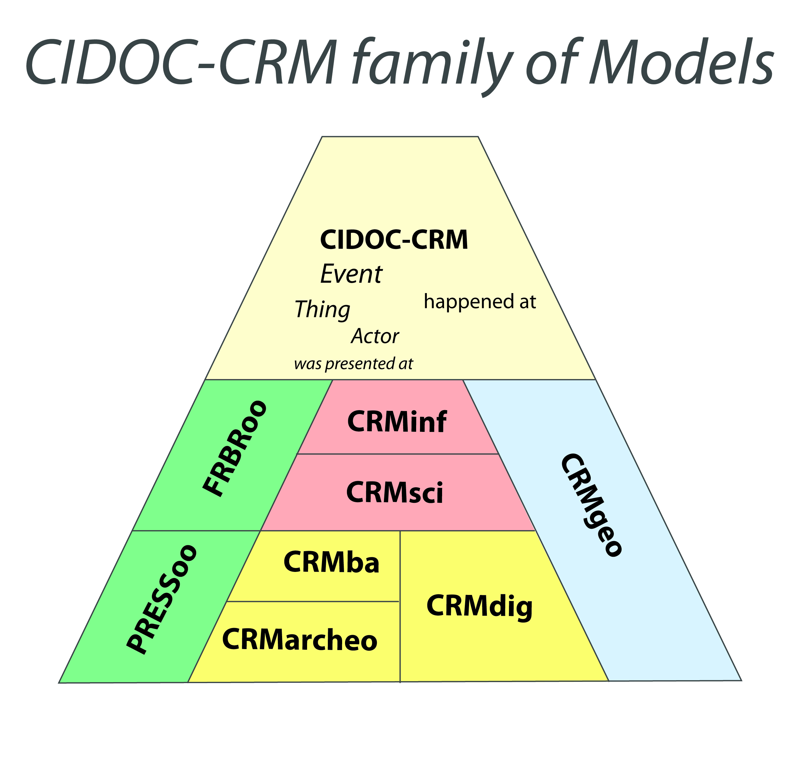
The CIDOC Conceptual Reference Model
  A collaboration with the International Council of Museums
  An ontology of +- 86 classes and 137 properties for culture and more
  With the capacity to explain hundreds of (meta)data formats
  International standard since 2006 - ISO 21127:2006, Renewed, 2014
  Event centric model

Slide 5
Update of Activities
Enabling Technologies
2. Methodology / Training
3. Thematic Research

Slide 6
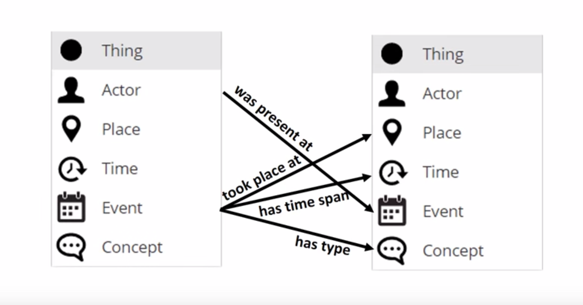
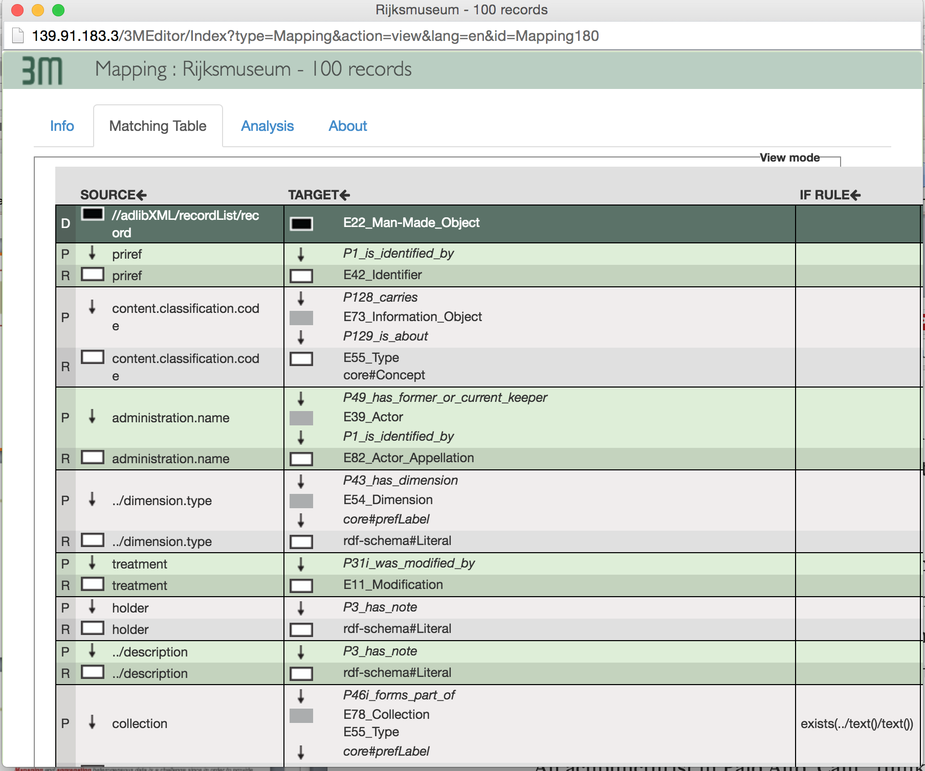
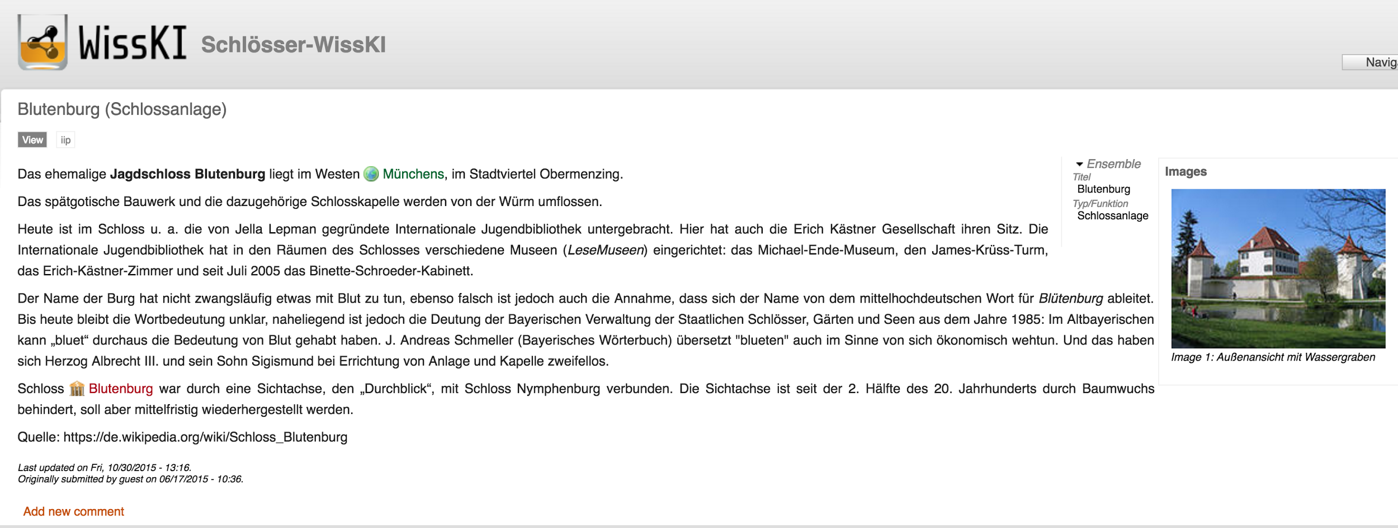
Enabling Technologies
Collaborating in supporting Semantic Data Mapping, Transformation, Query and Management
3M Mapping Memory Manager
ResearchSpace
WissKi Research Environment

Slide 7
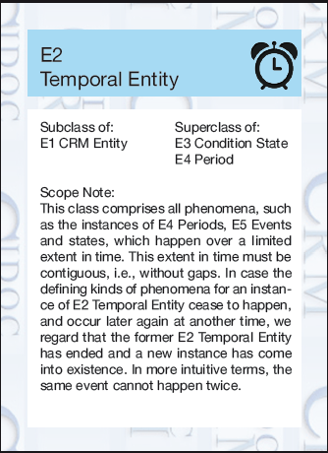

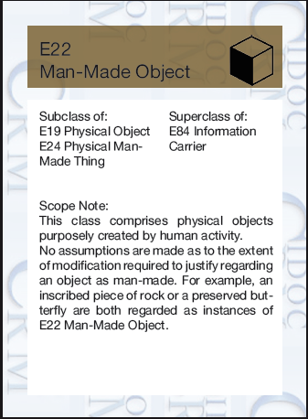
Methodology / Training
Workshops on Method in Knowledge Engineering
First Order Logic Representation of CRM
(C. Meghini)
Development of Training Materials for Dissemination of CRM
  What is a good concept?
  Mapping Workshops
  CRM Game
P17 was motivated by
P17(x,y) ⊃ E7(x)
P17(x,y) ⊃ E1(y)
P17 (x,y) ⊃ P15(x,y)

Slide 8
Topics
Semantics of Creative Processes
Extensions of FRBRoo work in new domains
DoReMus - music documentation collaboration
Documentation of architecture as creative process
Argumentation and Provenance
CRMinf
Investigation into building implementation tools for building structured argumentation datasets
Archaeology
Continued work on CRMArchaeo and CRMBa standards
Application in Ariadne Project
New work begun on extension for archaeological survey
Research Infrastructures (Collaboration)
Wisski
Research Space
Parthenos Project

Slide 9
Welcome to all
Thank you
http://www.cidoc-crm.org/

