Slide 1
Digital Preservation WG
Susanne Nickel
ICOM CIDOC
Milano 2016-07-03

Slide 2
Chairs Report
2015
  Invitation to review UNECSO Guidelines
  Comments and new chapters
2016
  Suggested short version of guidelines
  Organizing Panel discussion about guidelines
  Consultation with national secretariat for digitalization questions in Sweden

Slide 3
Communication and Membership
  20 members
  Googlegroups mailinglist
  What do we need?

Slide 4
UNESCO Guidelines
Comments?
Thoughts?
Ideas?
Notes:
Who has had a look on it?
Give summary: most important to me: decision trees (like questionaire for physical objects), and metadata
Discussion

Slide 5
Agenda 2016-2019
Suggestions?
Notes:
My ideas:
Checking the 10 points
Short version of guidelines
New website (coming soon)
Definition of digital preservation and its documentation
Standard workflow?

Slide 6
Agenda 2016-2019
Chairs suggestion
Guidelines how to document digital preservation
Continuing UNESCO PERSIST
Training material on digital preservation for CIDOC training
Notes:
Suggestions not adoped by assembly

Slide 7
Defintions
Digital preservation is a set of procedures actions, decisions and rules with the aim of keeping museum data available and understandable in the long term.
Every digital object with all its significant properties and metadata should be findable, retrievable and accessible whilst ensuring their authenticity
Notes:
Suggested at meeting in Dresden 214
Is that right? Durable?

Slide 8
Needs
Structure (data)
Procedures not tools
Rules/guidelines
Responsibilities
Priority
Money
Sustainable organisation
Finding a position
  Politics
  Technics
  Museum
Notes:
Definded by CIDOC WG digi pres in dresden 2014

Slide 9
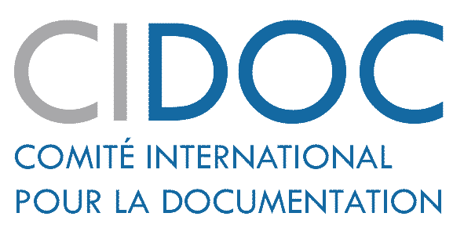

Thank You
Contact details:
  Email:- susanne.nickel@eskilstuna.se
  CIDOC web site:- cidoc.icom.museum

